Slide 1
Swiffer Project “Upside Down”
Location Scout Book
Location Manager: Dimitrije Fisic
2 February 2026
Production Office: Northern Kentucky University

Slide 2
Creative Overview
Real, lived-in residential environments
Clear, visually satisfying cleaning demonstrations
Kitchens and bathrooms prioritized
All products must work across two final locations
Sync sound considered for all interiors

Slide 3
Scouting Overview
Five locations scouted for director and producer review
Two final locations to be selected
One-day location scout
Southwest Ohio & Northern Kentucky region

Slide 4
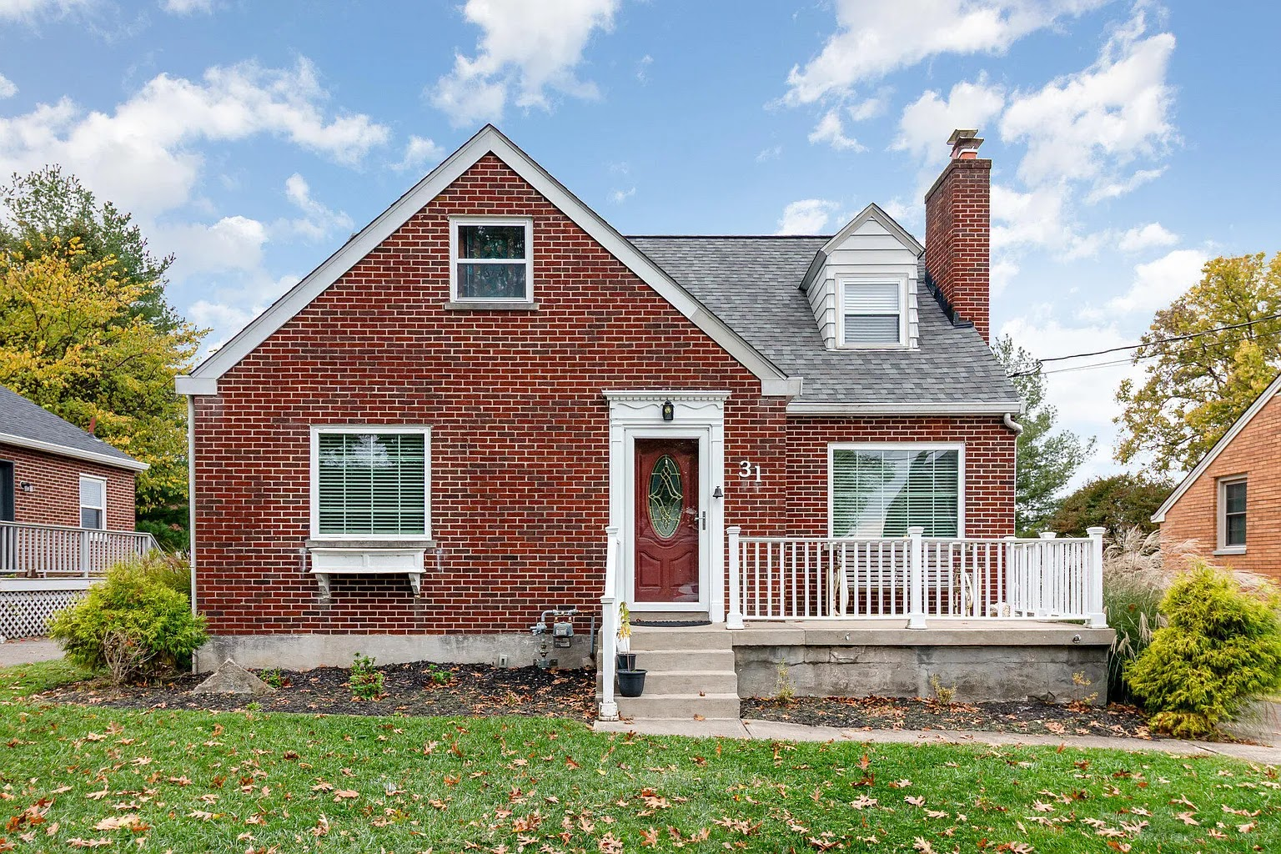
LOCATION INFO
Location 1 – Single-Family Home
31 Broadview Pl
Fort Thomas, KY 41075
Approx. 15 minutes from NKU

Slide 5
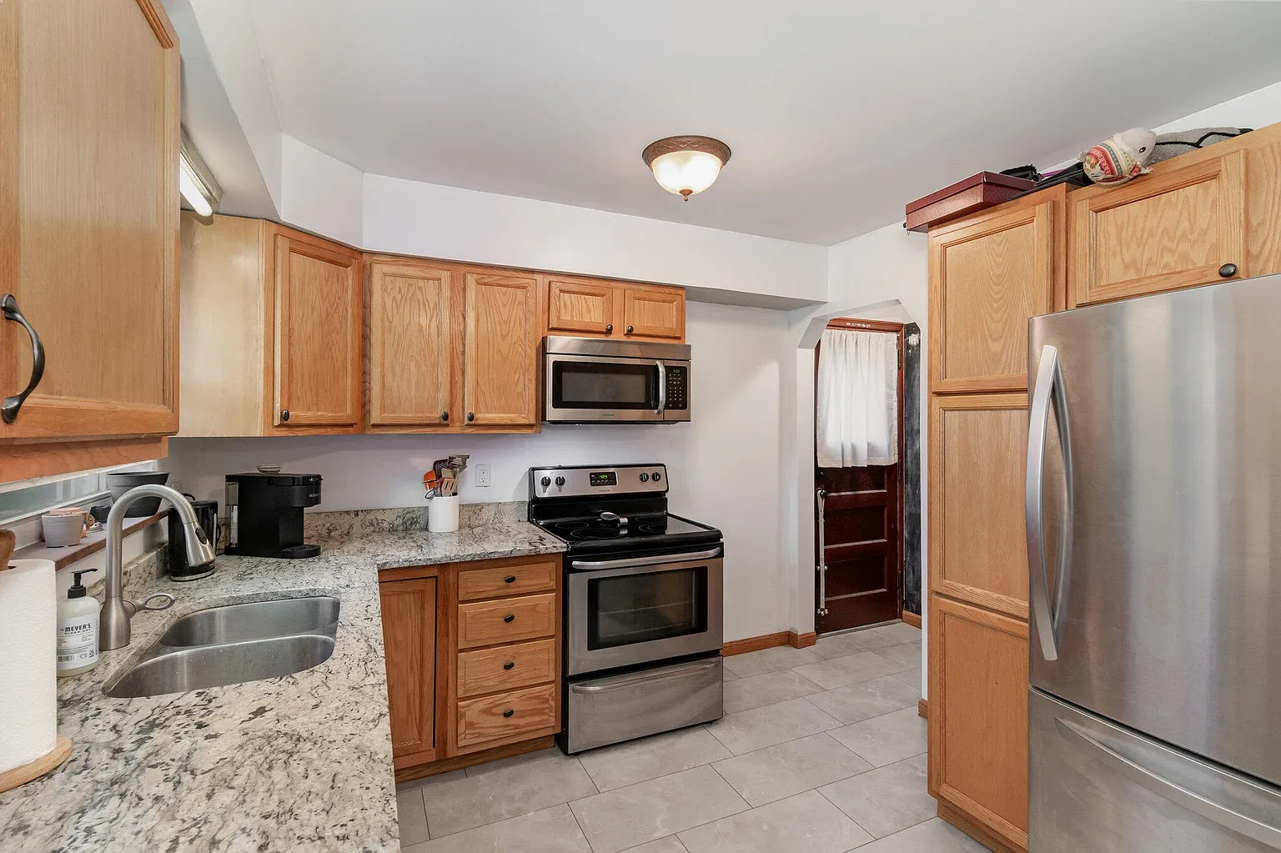
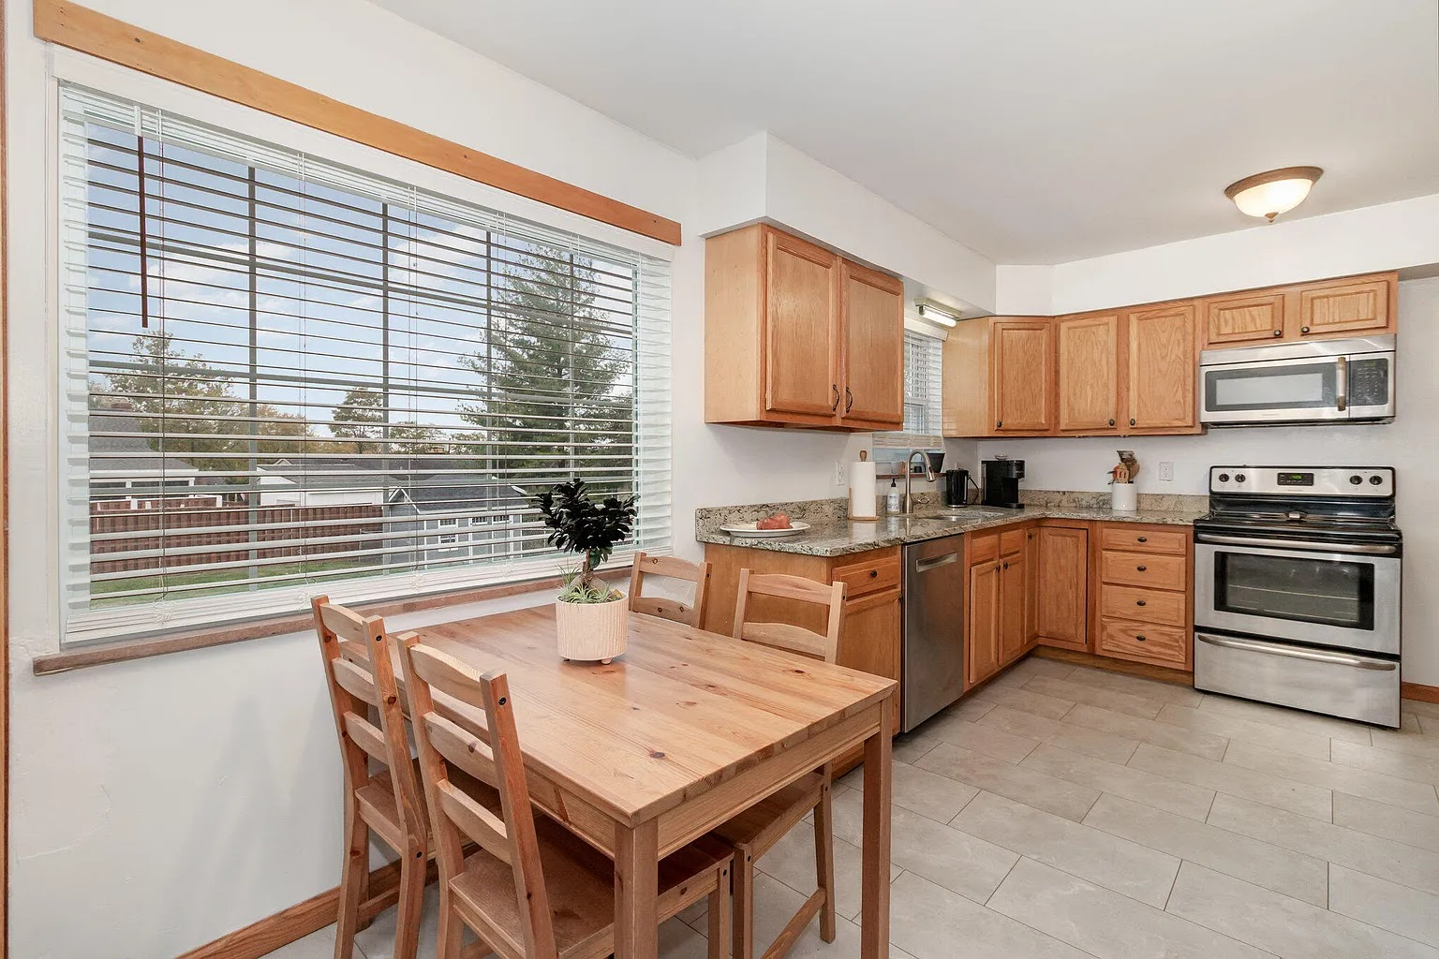
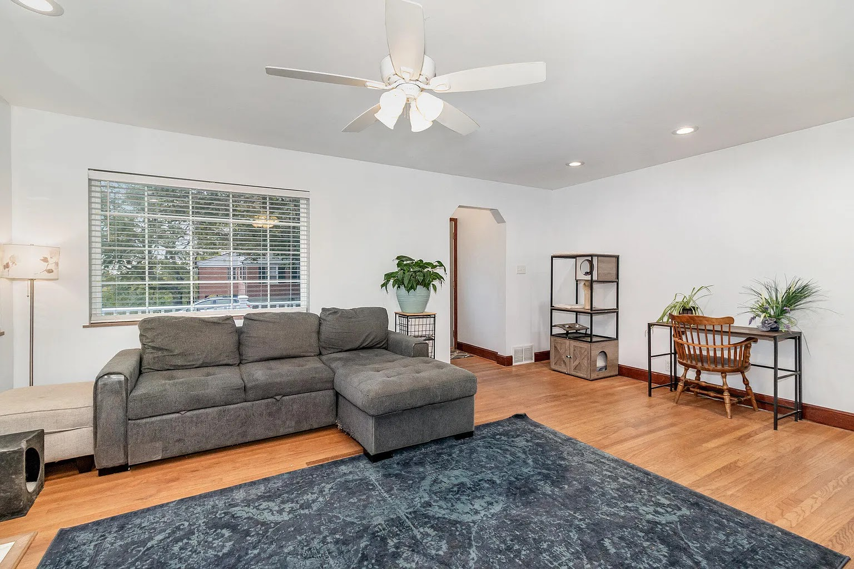
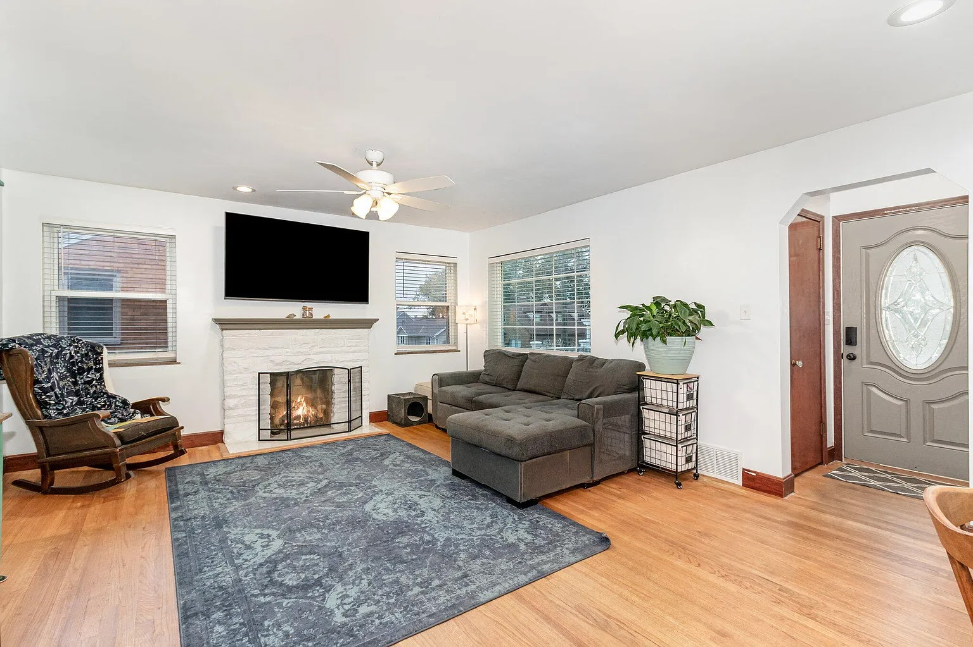
LOCATION PHOTOS
Ceramic Tile – Kitchen
Primary wet demo zone (Power Mop / Sweep & Mop Deluxe)
Why this works:
Long tile runs
Clean grout lines
Plenty of clearance for tracking shots
Ceramic Tile – Kitchen / Dining
Secondary wet demo + lifestyle framing
Why this works:
Shows depth
Natural light from window
Lets director see alternate blocking
Hardwood Floor – Living Room
Dry & Heavy Duty Dry demos
Why this works:
Continuous hardwood
Clear contrast against rug
Excellent before/after potential
Hardwood Floor + Ceiling Fan + TV Above Fireplace
Primary Swiffer Duster demo zone
Why this works:
Ceiling fan = vertical dust
High-mounted TV = premium Duster shot
Fireplace mantle adds realism

Slide 6
Products
Pros
Cons
Swiffer Sweep & Mop Deluxe
Hardwood living areas provide long, uninterrupted cleaning paths
Swiffer Power Mop
Ceramic kitchen tile allows for strong wet demo and shine shots
Swiffer Dry & Heavy Duty Dry
Hardwood floors offer high contrast for dust and debris pickup
Swiffer Duster
Ceiling fans, high cabinets, and TV above fireplace provide clear vertical dust zones
Excellent natural light throughout primary living spaces
Long ceramic tile runs ideal for wet demonstrations
Multiple strong vertical dust zones for Duster content
Ample on-property parking for crew and vehicles
Residential neighborhood with potential for intermittent exterior noise (lawn equipment, traffic, neighbors)
May require coordination with neighbors for quiet during sync sound
Exterior activity subject to weather and seasonal conditions

Slide 7
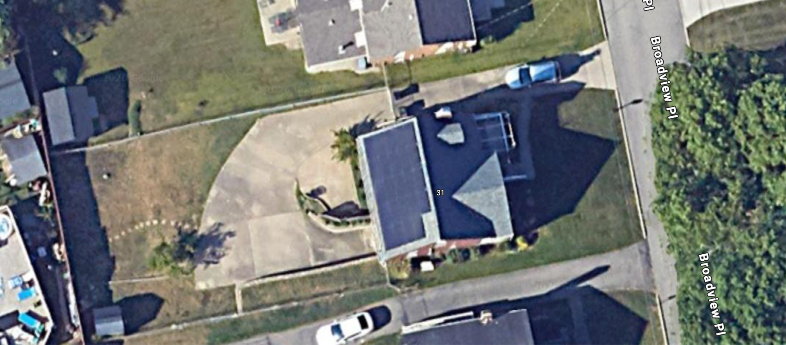
Crew Parking(Curb)
Grip Van
Prop Truck
Generator

Slide 8
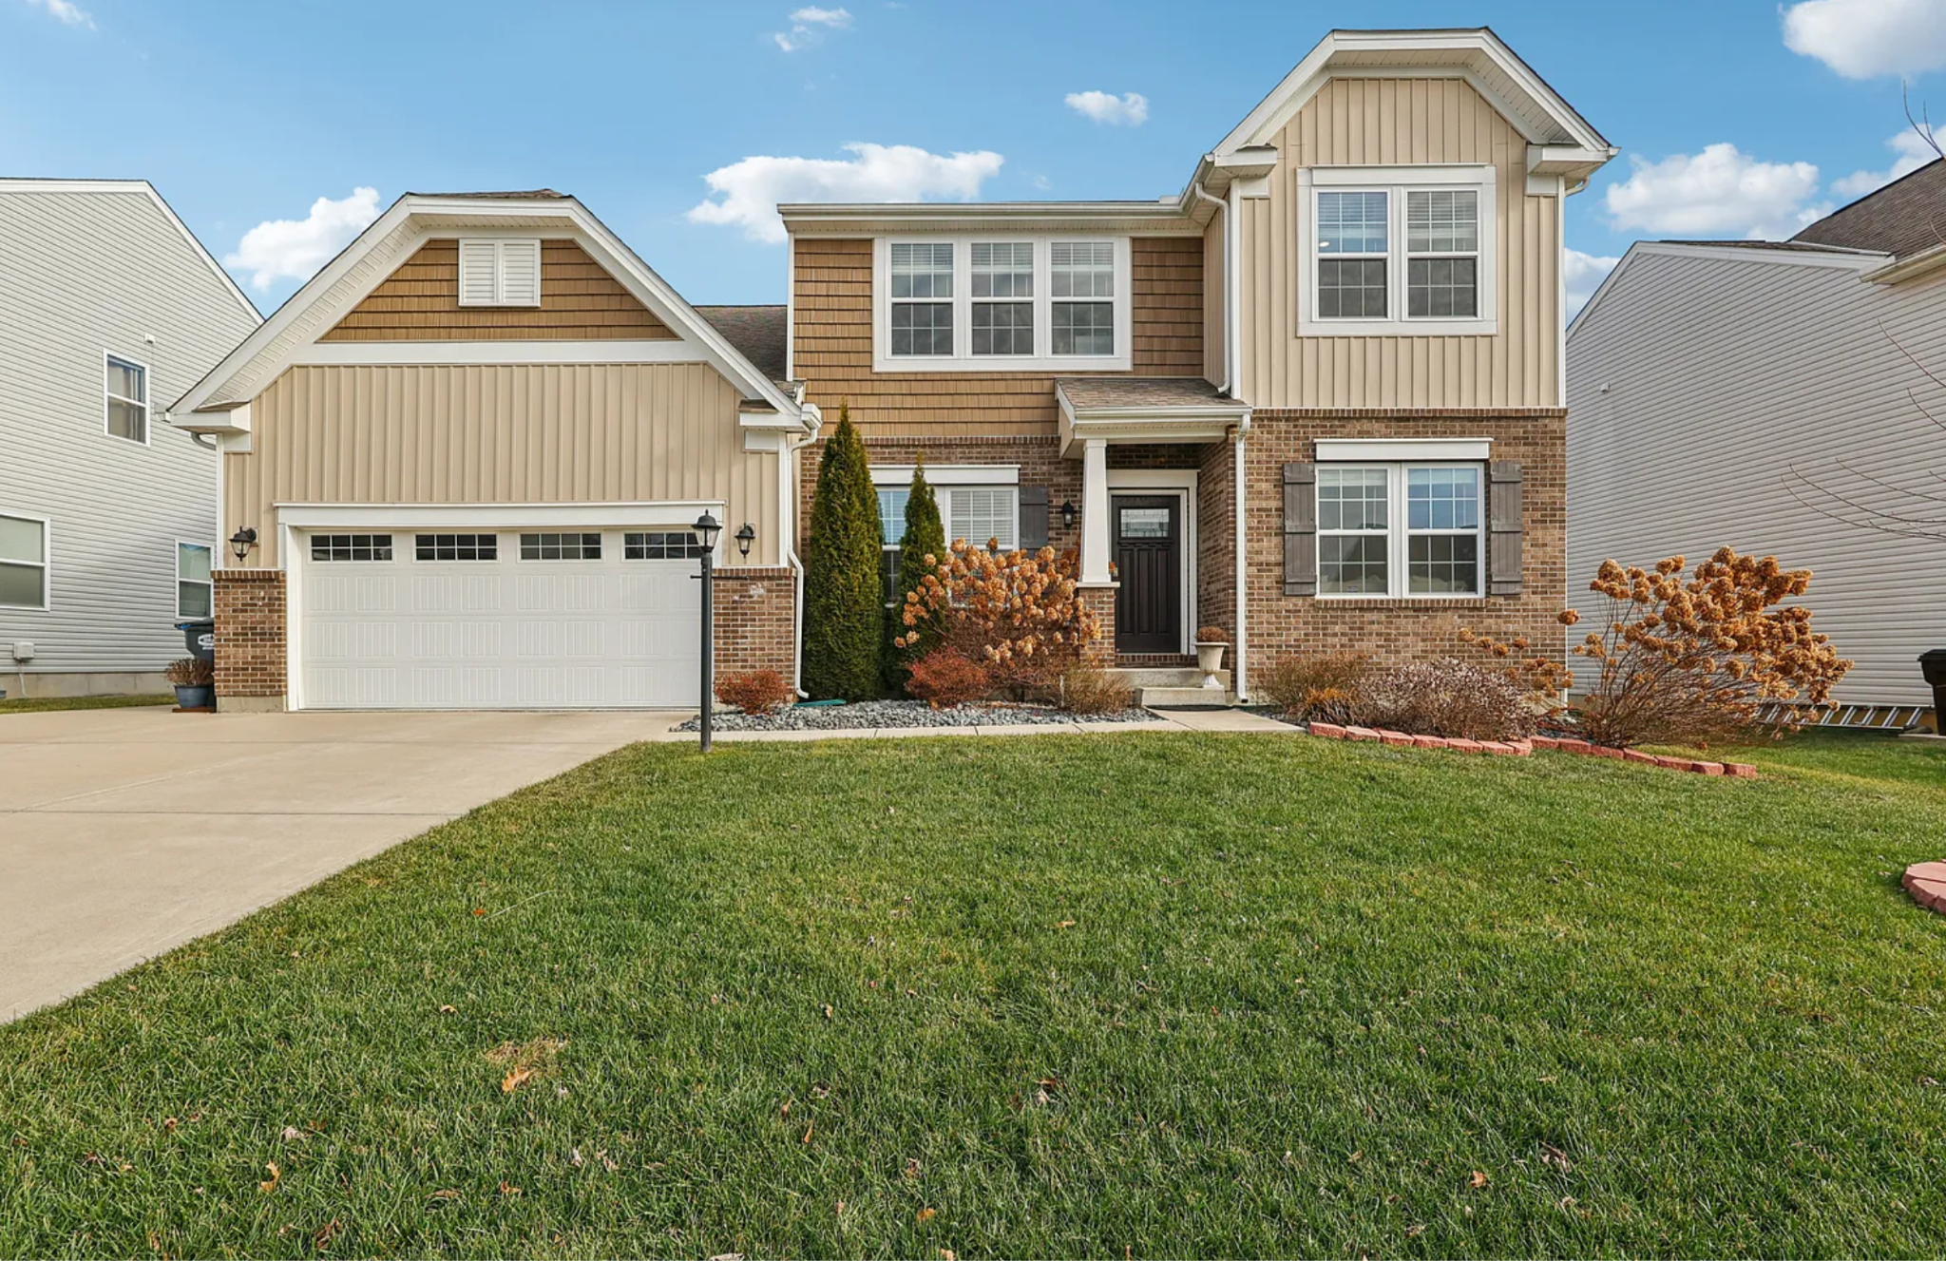
LOCATION INFO
Location 2 – Single-Family Home
6468 Graham Ct
Burlington, KY 41005
Approx. 25 minutes from NKU

Slide 9
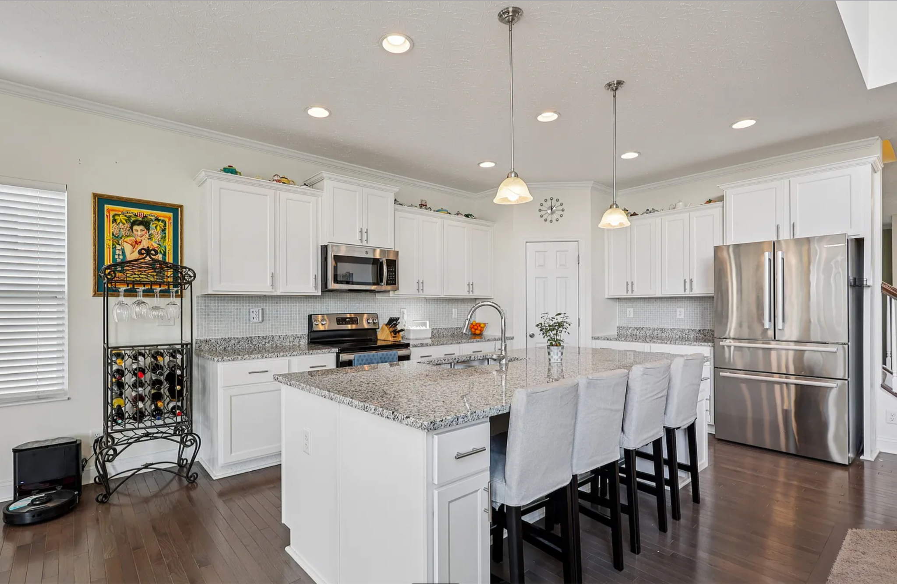
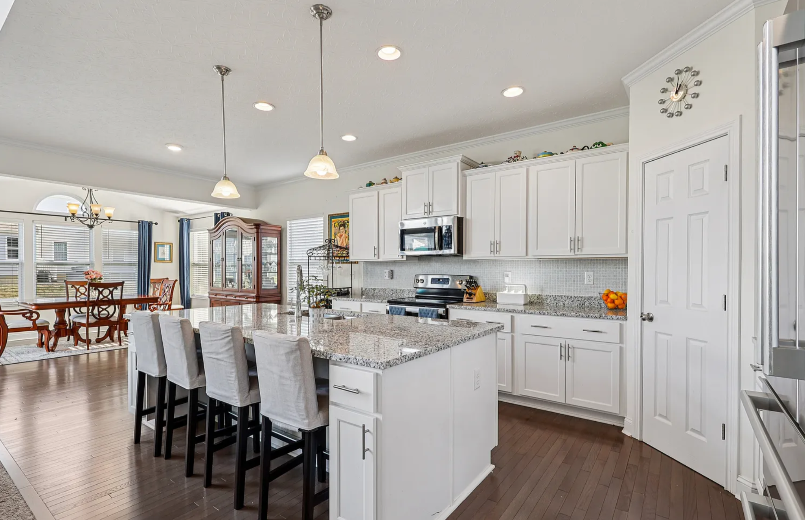
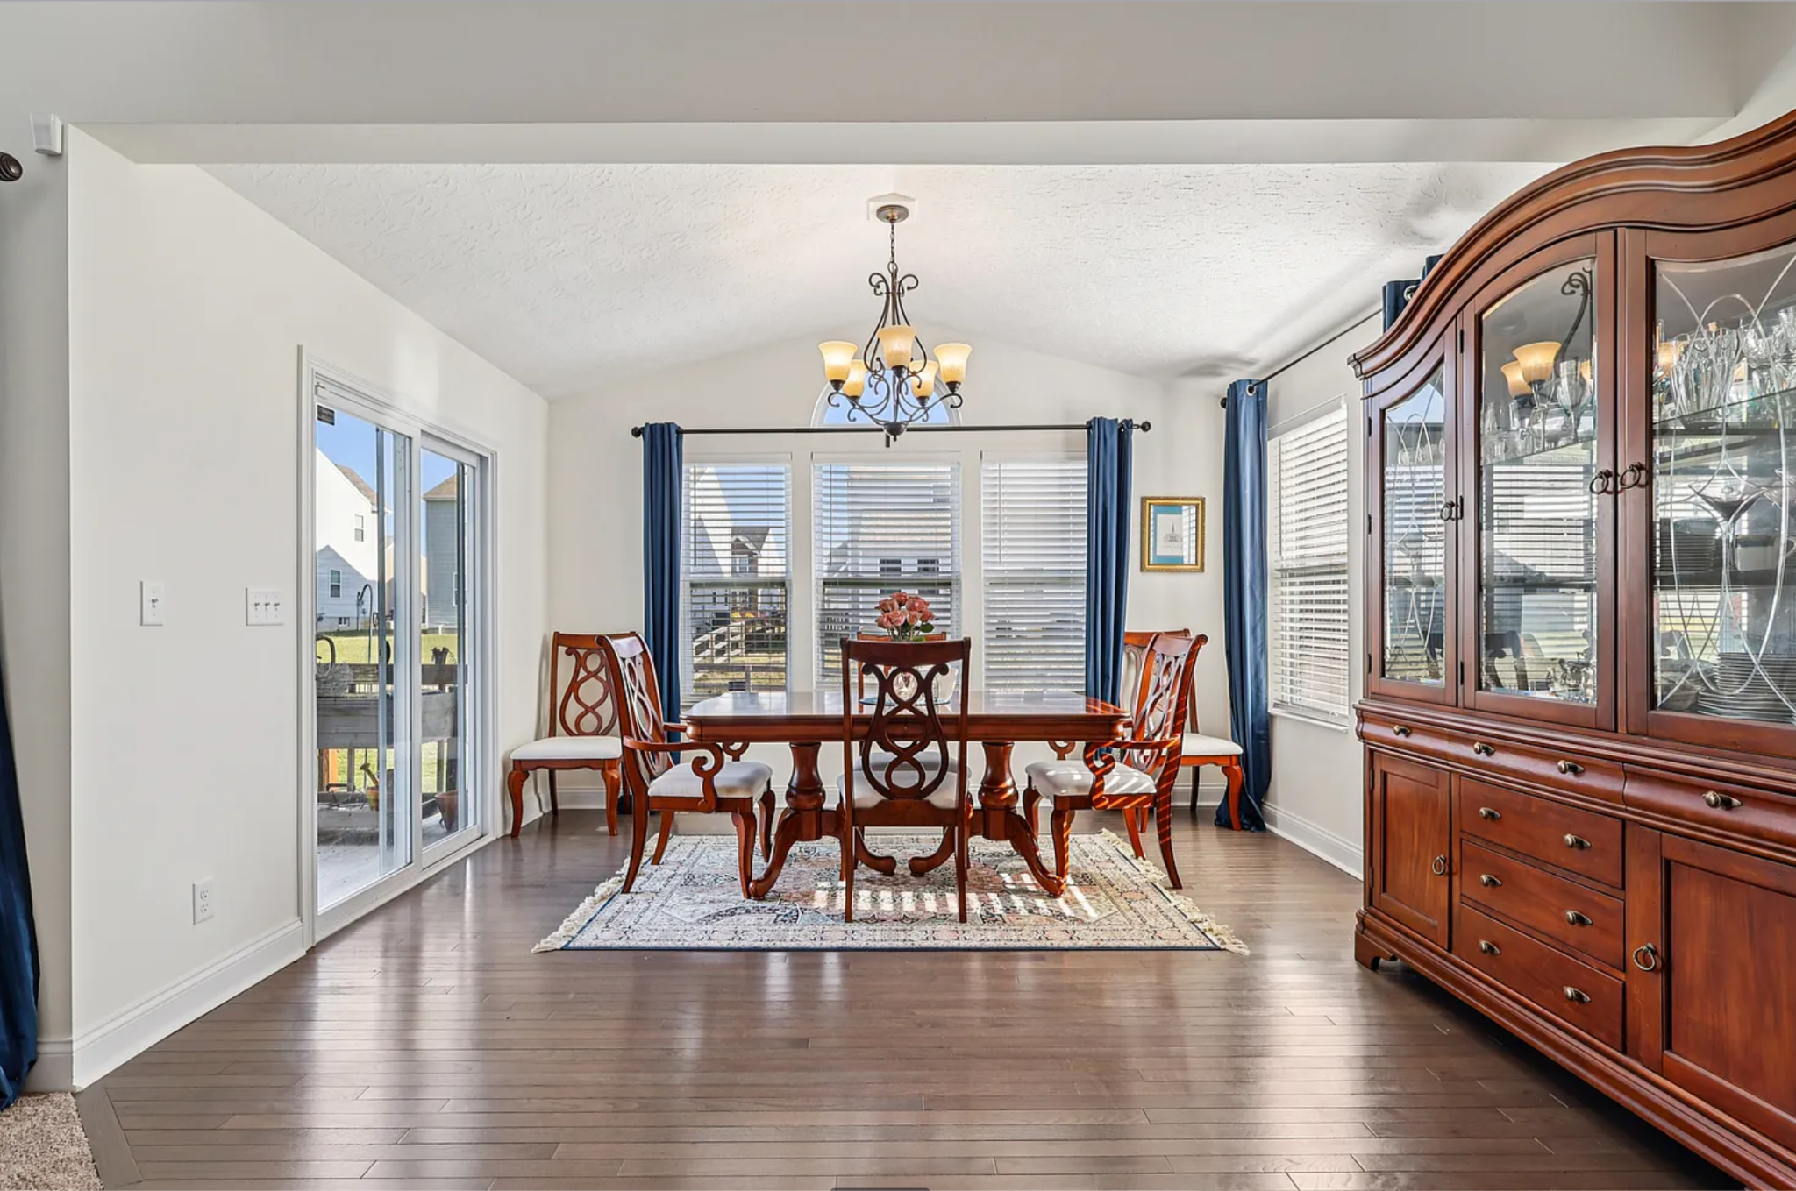
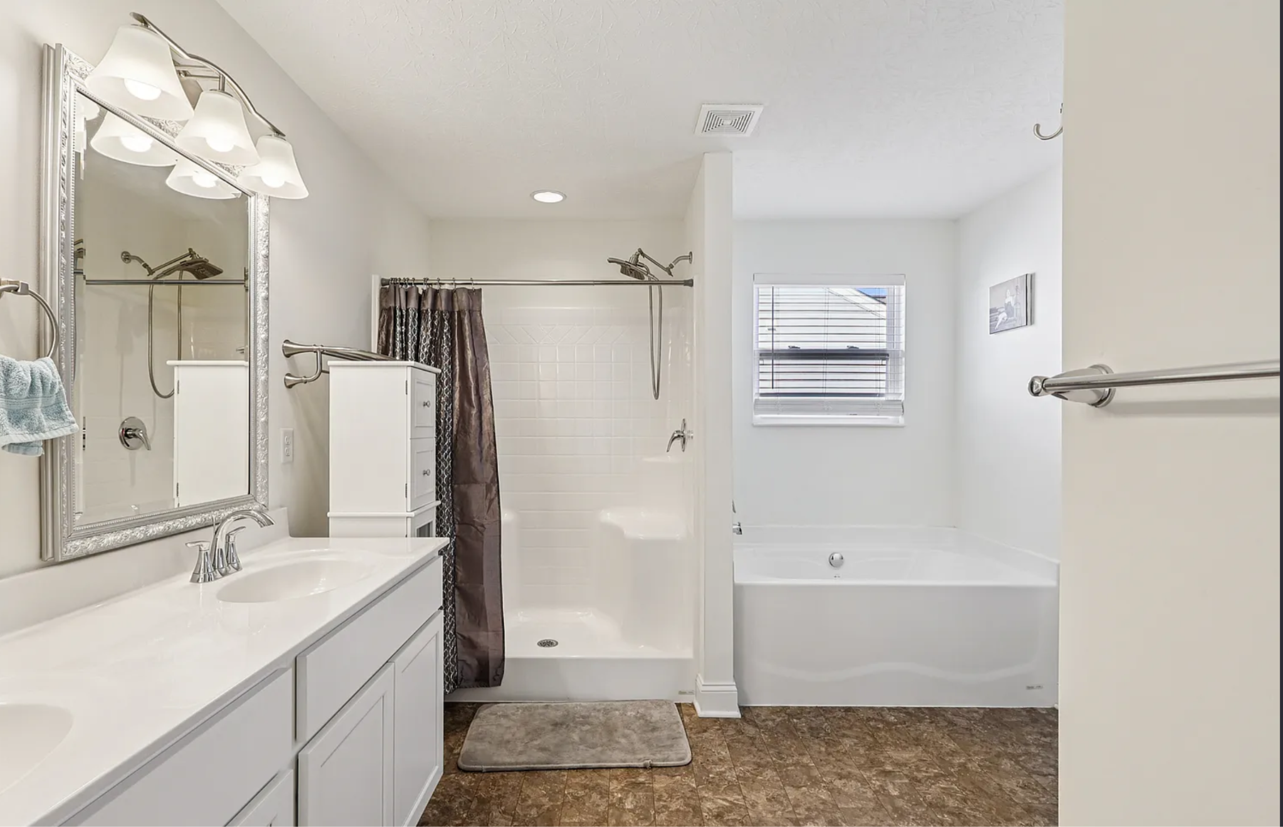
LOCATION PHOTOS
Hardwood Floor – Kitchen
Primary dry demo zone
(Dry & Heavy Duty Dry)
Why this works:
• Open floor plan
• Clean sightlines for tracking shots
• Strong contrast for debris pickup
Hardwood Floor – Kitchen / Dining
Lifestyle framing + alternate blocking
Why this works:
• Shows depth
• Natural light from multiple windows
• Flexible camera angles
Hardwood Floor + Chandelier
Primary Swiffer Duster demo zone
Why this works:
• Hanging fixture = vertical dust
• Window light enhances particles
• Premium, realistic setting
Tile – Master Bathroom
Primary wet demo zone
(Power Mop / Sweep & Mop Deluxe)
Why this works:
• Confirmed tile surface
• Clean grout lines
• Strong backup wet demo location

Slide 10
Products
Pros
Cons
Swiffer Sweep & Mop Deluxe
Hardwood kitchen and dining areas provide long, uninterrupted cleaning paths
Swiffer Power Mop
Master bathroom tile supports controlled wet demo and shine shots
Swiffer Dry & Heavy Duty Dry
Hardwood floors offer strong contrast for dust and debris pickup
Swiffer Duster
Chandelier and upper kitchen cabinets provide clear vertical dust zones
Open floor plan with strong sightlines for camera movement
Excellent natural light throughout kitchen and dining areas
Large kitchen island provides flexible staging and blocking space
Multiple strong vertical dust zones (chandelier, upper cabinets)
Spacious layout supports multiple product demonstrations
Primary wet demo surface limited to master bathroom tile
Basement laundry area has limited natural light
Residential neighborhood with potential for intermittent exterior noise
Longer travel time from production office compared to central locations

Slide 11
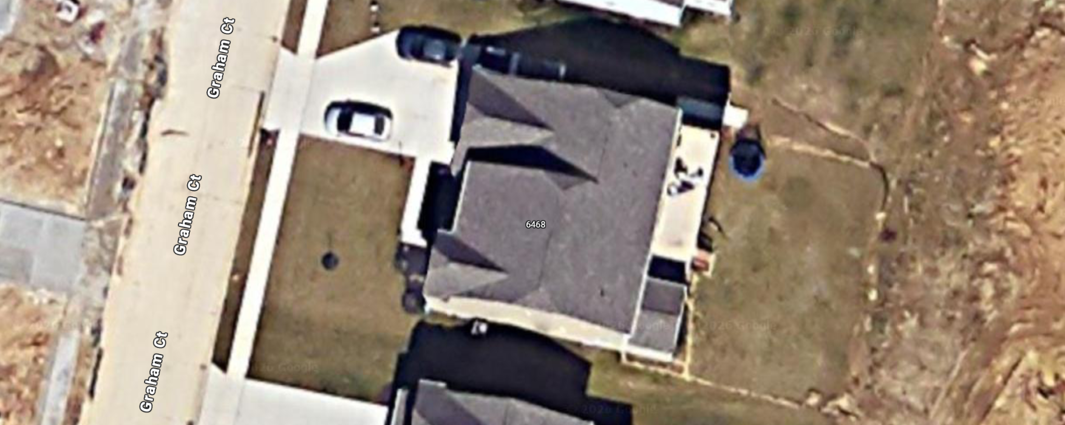
Crew Parking(Curb)
Grip Van
z
Prop Truck
Generator

Slide 12
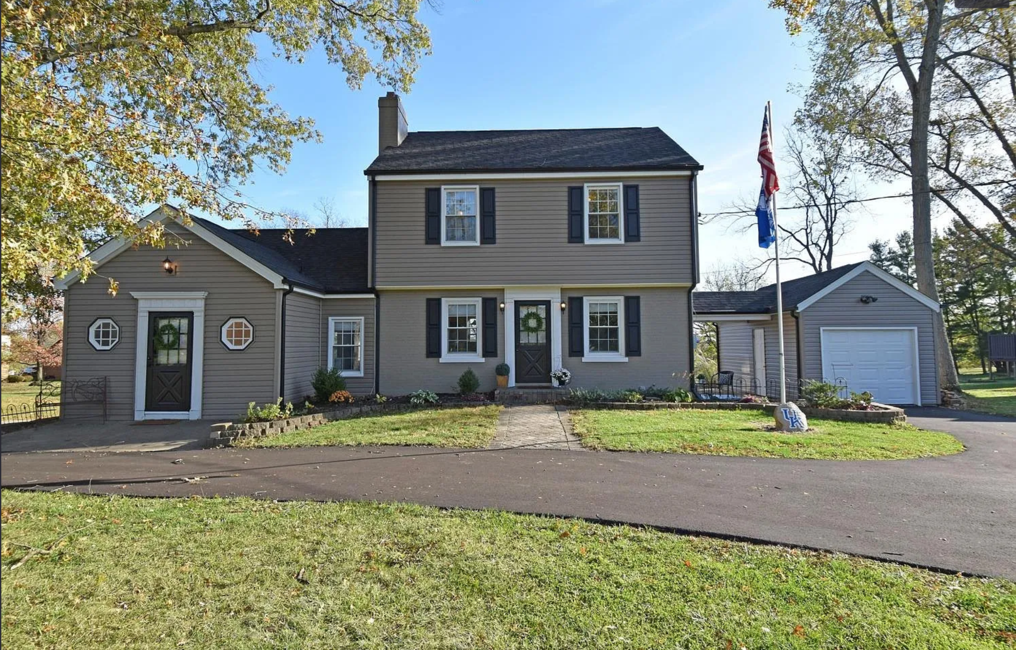
LOCATION INFO
Location 3 – Single-Family Home
6009 Cleves Warsaw Rd
Cincinnati, OH 45233
Approx. 30 minutes from NKU

Slide 13
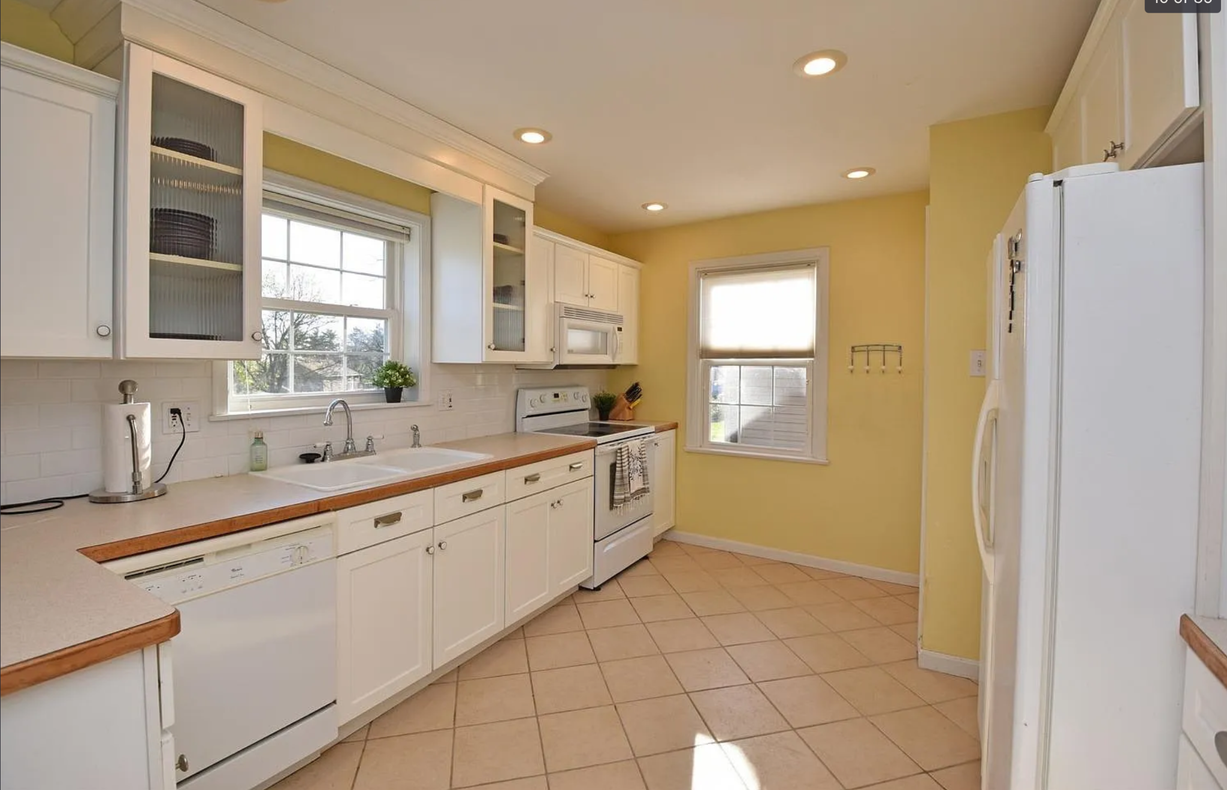
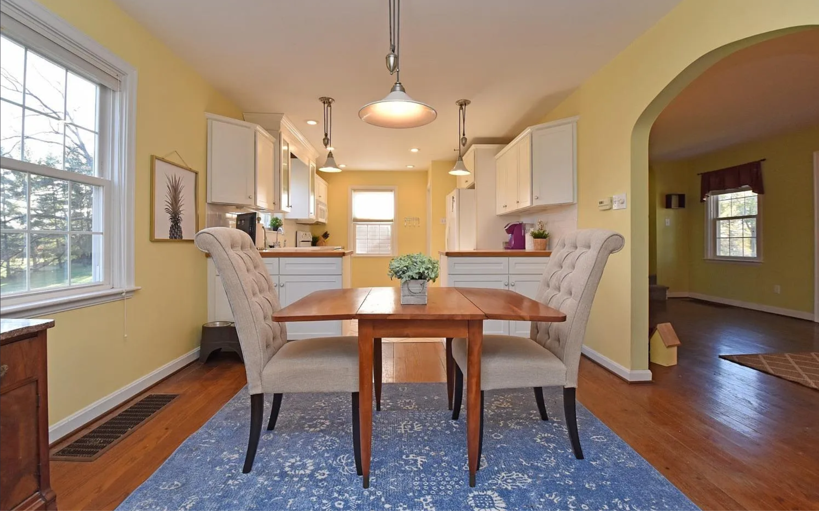
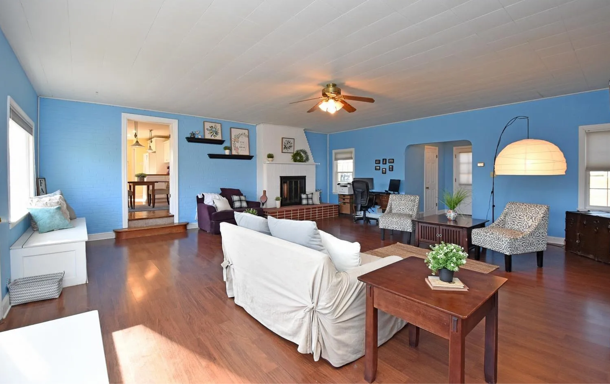
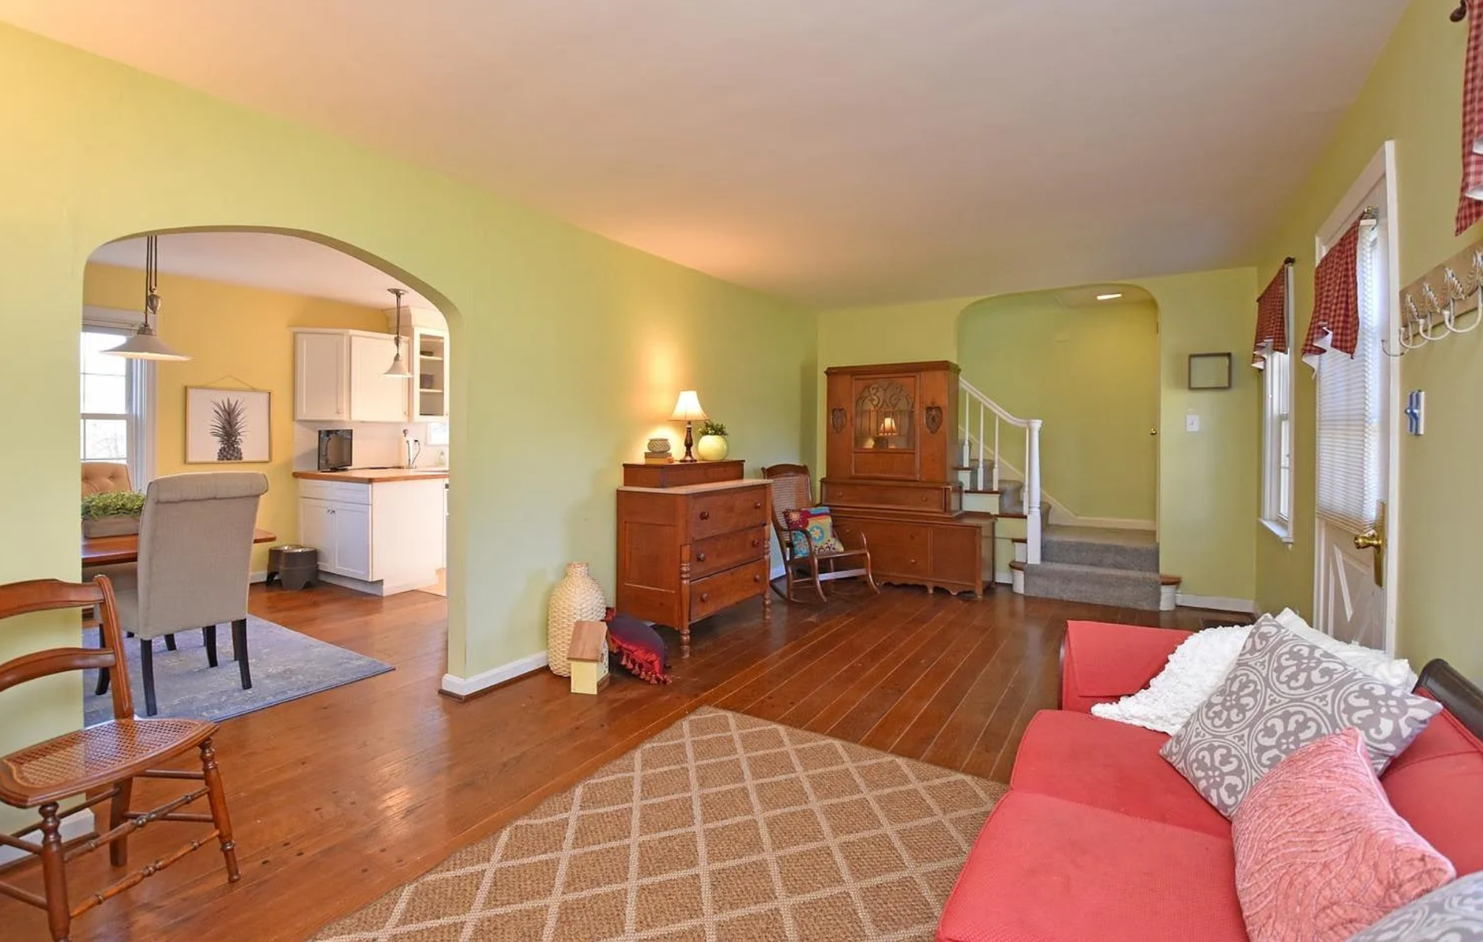
LOCATION PHOTOS
Ceramic Tile – Kitchen
Primary wet demo zone
(Power Mop / Sweep & Mop Deluxe)
Why this works:
• Light-colored tile enhances shine shots
• Clean grout lines for before/after clarity
• Natural window light improves visibility
• Straight layout for tracking shots
Hardwood Floor – Kitchen / Dining
Lifestyle framing + alternate blocking
Why this works:
• Shows room depth and flow
• Multiple camera angles available
• Connects kitchen + living areas
• Strong continuity for movement shots
Hardwood Floor + Fireplace / Ceiling Fan
Primary Swiffer Duster demo zone
Why this works:
• Mantle + shelves = vertical dust zones
• Ceiling fan captures airborne particles
• High-contrast flooring for dust pickup
• Visually strong “hero” living room
Hardwood Floor – Dining / Living Transition
Secondary dry demo + lifestyle zone
Why this works:
• Clean sightlines through archway
• Good depth for wide shots
• Flexible furniture blocking
• Natural light from multiple windows

Slide 14
Products
Pros
Cons
Swiffer Sweep & Mop Deluxe
Ceramic kitchen tile supports strong wet demos and visible shine results
Swiffer Power Mop
Light-colored tile enhances liquid pickup and streak-free finishes
Swiffer Dry & Heavy Duty Dry
Hardwood living and dining floors provide high contrast for debris removal
Swiffer Duster
Ceiling fan, shelves, and fireplace create clear vertical dust zones
Strong natural light in kitchen and main living spaces
Light tile and warm hardwood create excellent before/after contrast
Open connection between kitchen, dining, and living areas
Fireplace and built-ins add visual interest for lifestyle shots
Multiple usable demo zones in compact footprint
Located on main road (Cleves Warsaw Rd) with potential traffic noise
Limited on-site parking compared to suburban locations
Smaller kitchen footprint may restrict crew movement
Exterior sound control may be needed during sync audio
May require off-site parking coordination for larger vehicles

Slide 15
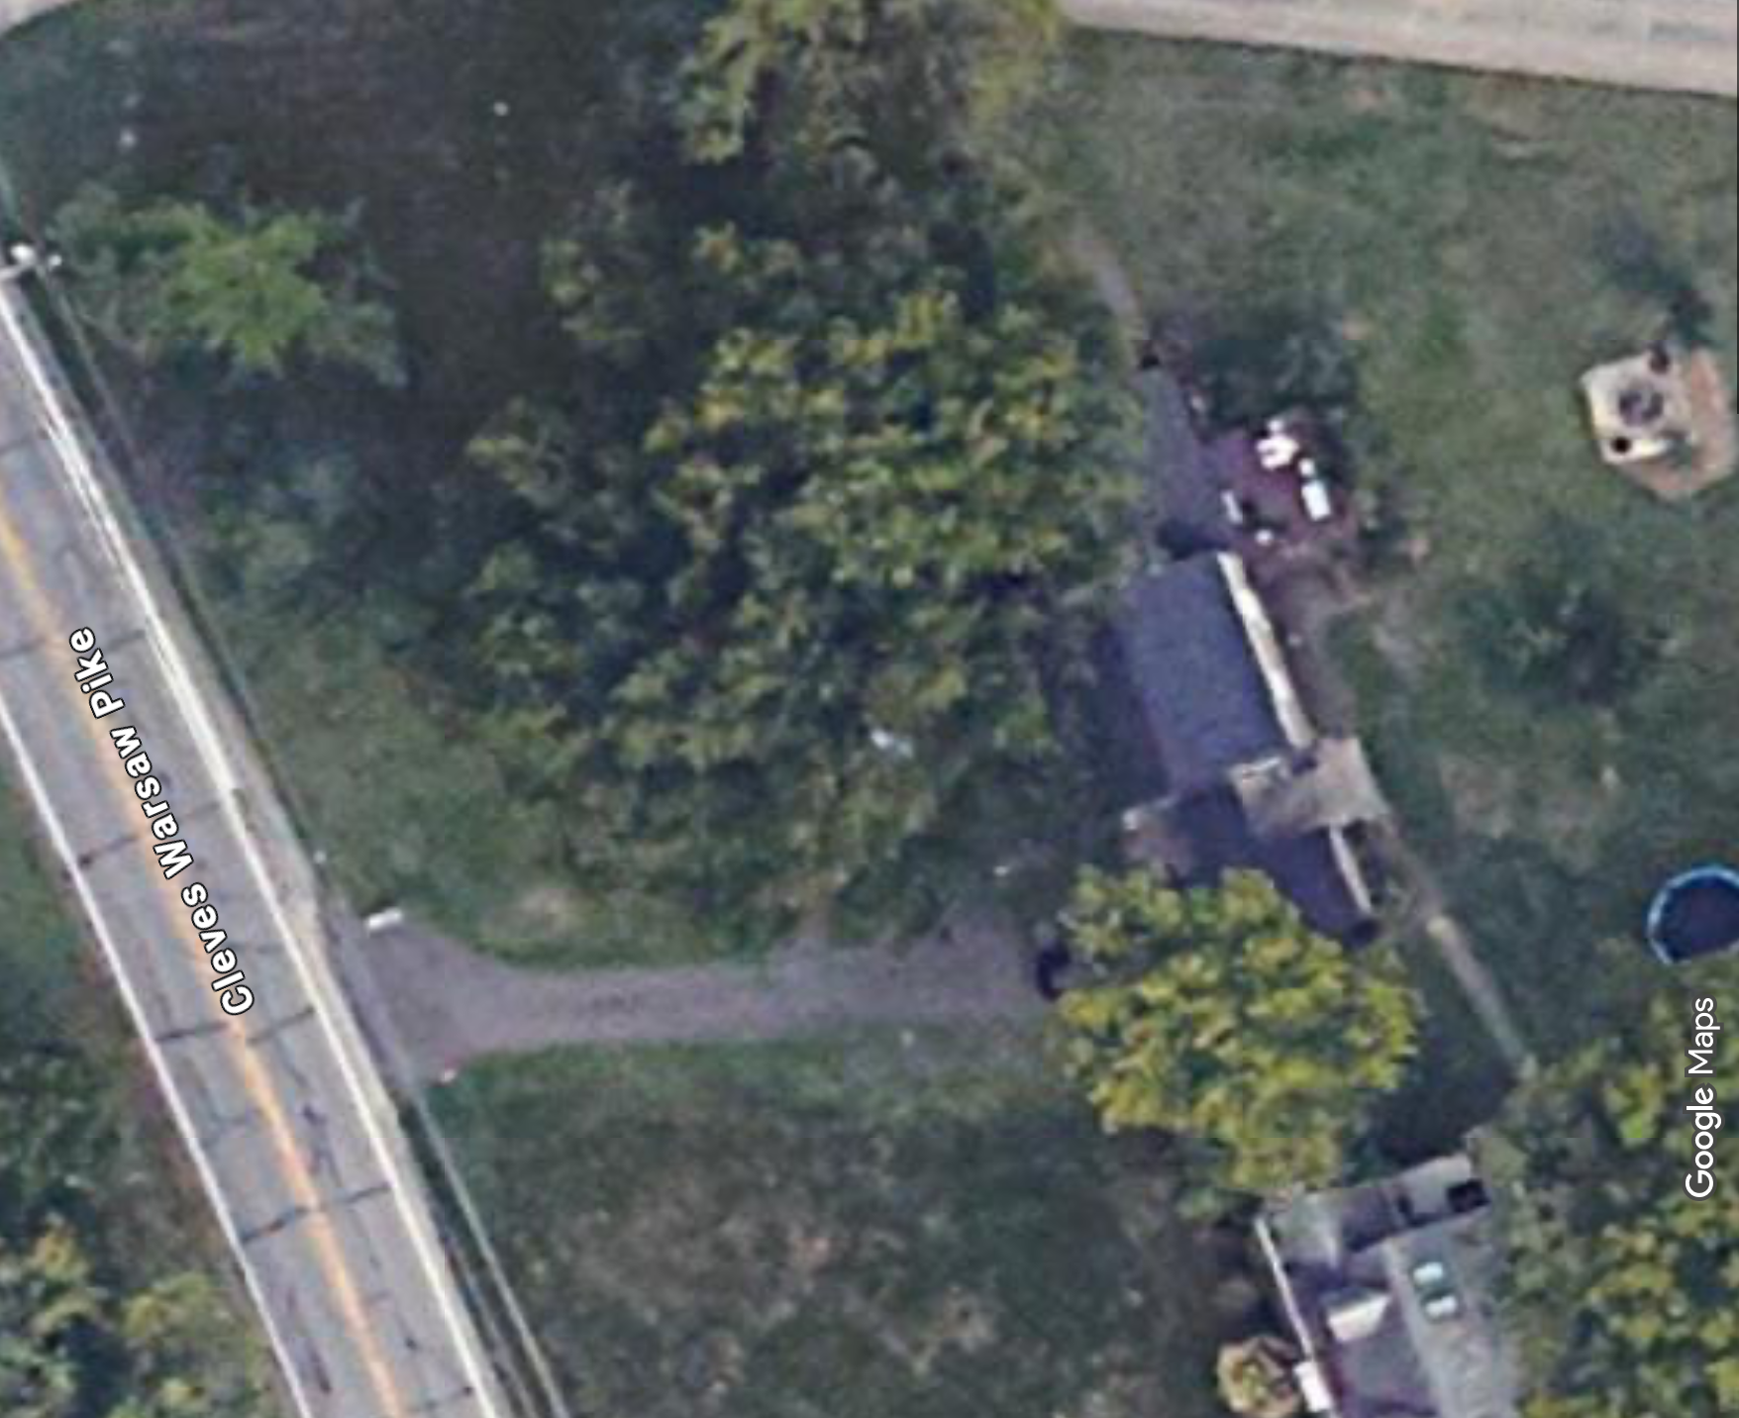
Generator
Crew Parking (Weather-Dependent)
z
Grip Van
Prop Truck

Slide 16
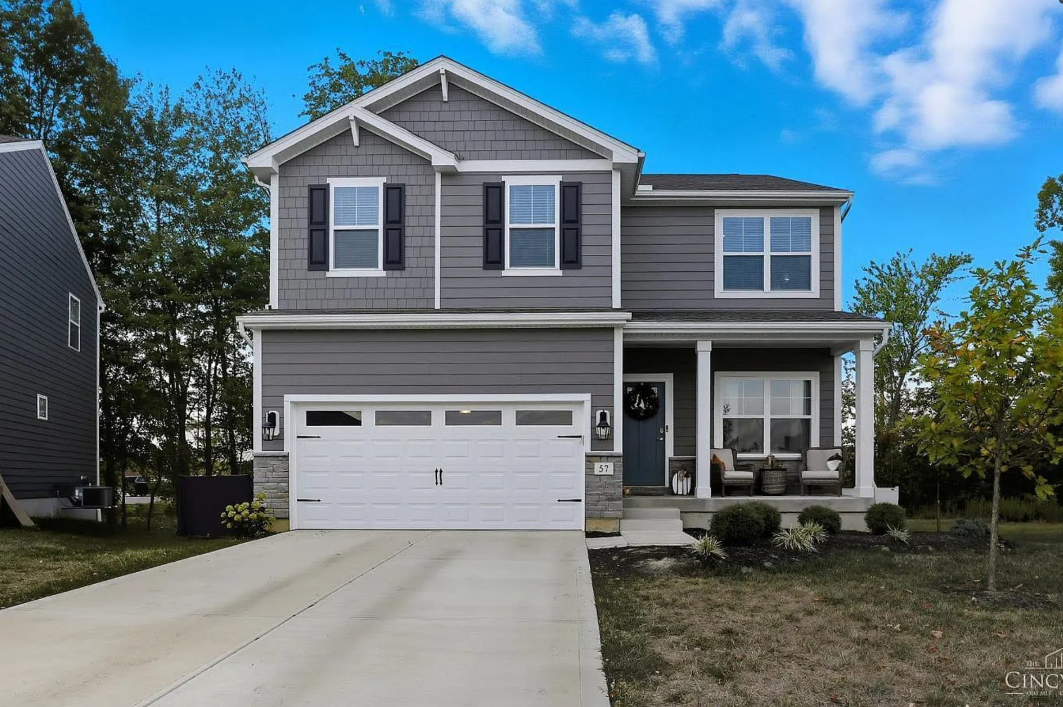
LOCATION INFO
Location 4 – Single-Family Home
57 Marigold Ln
Amelia, OH 45102
Approx. 40 minutes from NKU

Slide 17
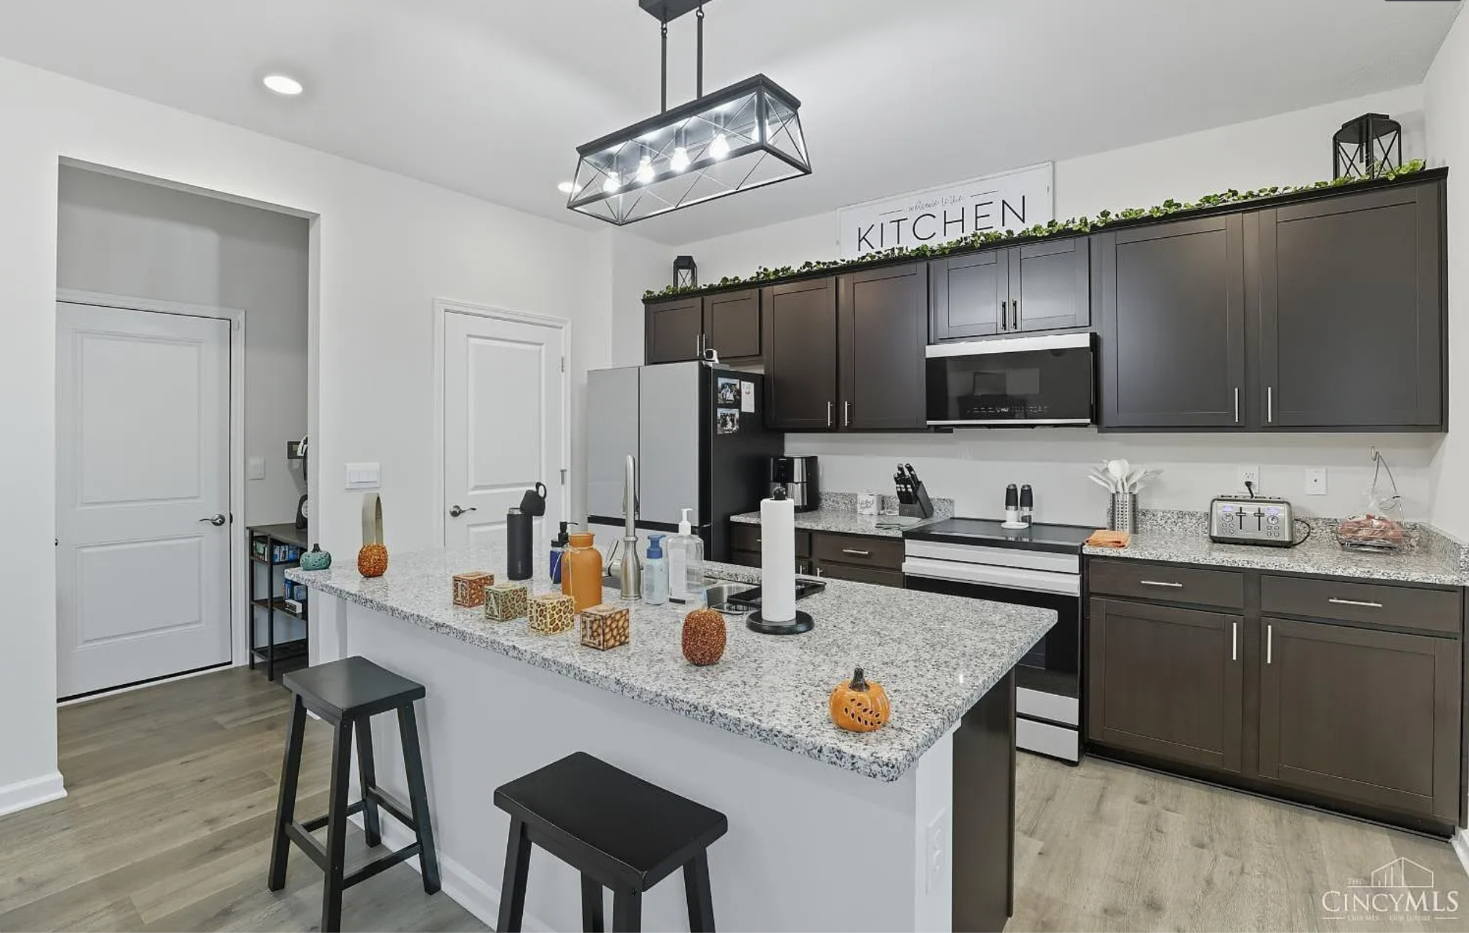
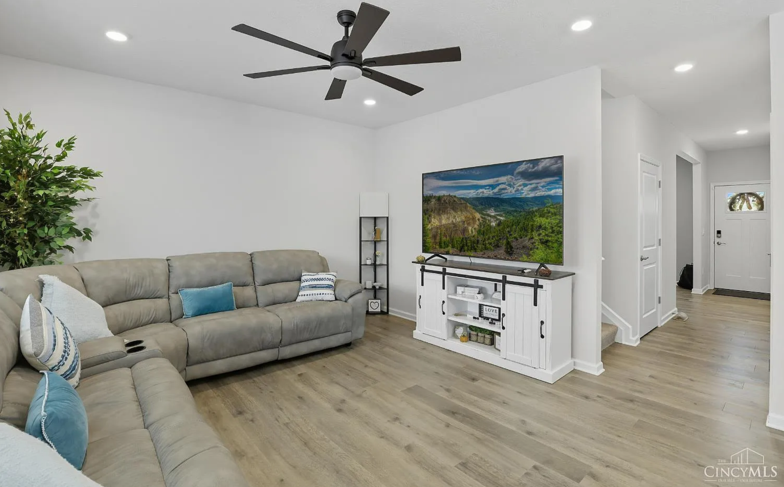
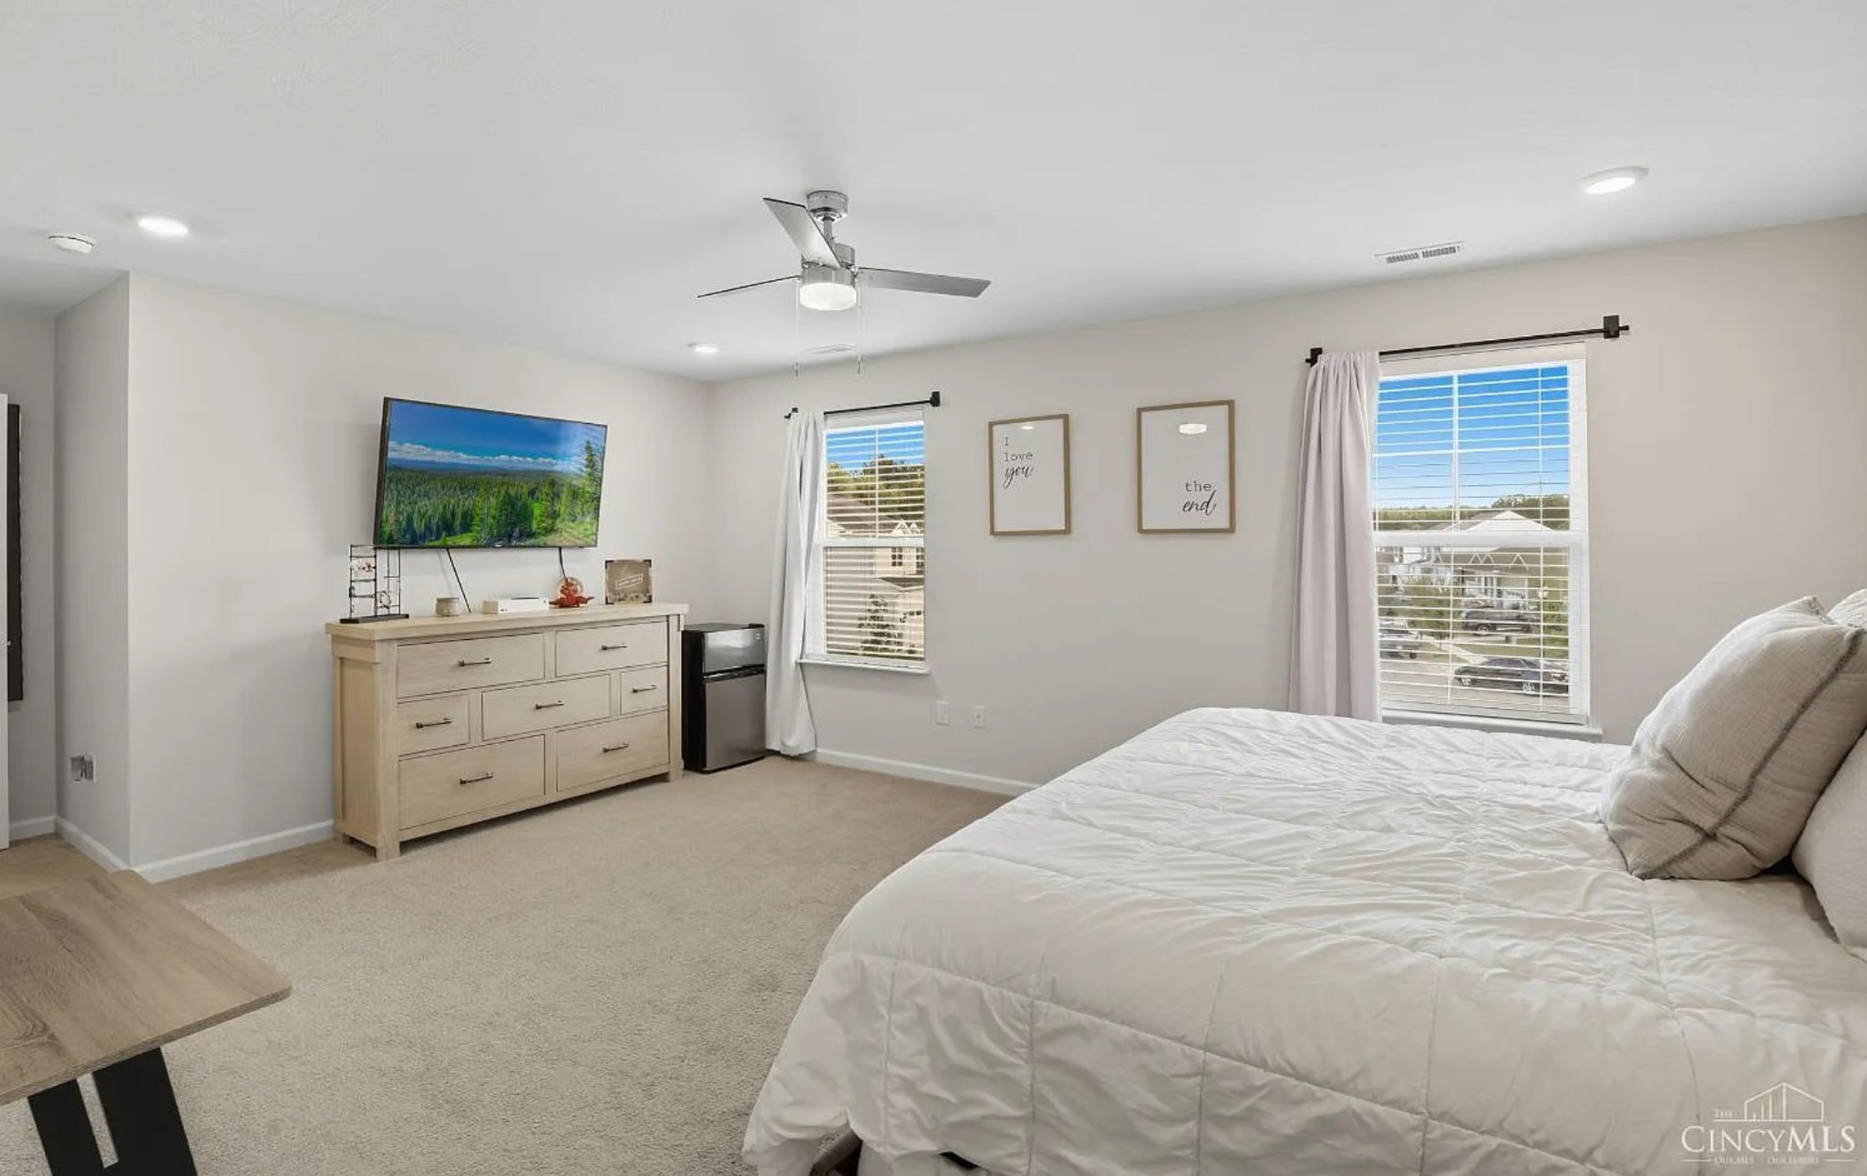
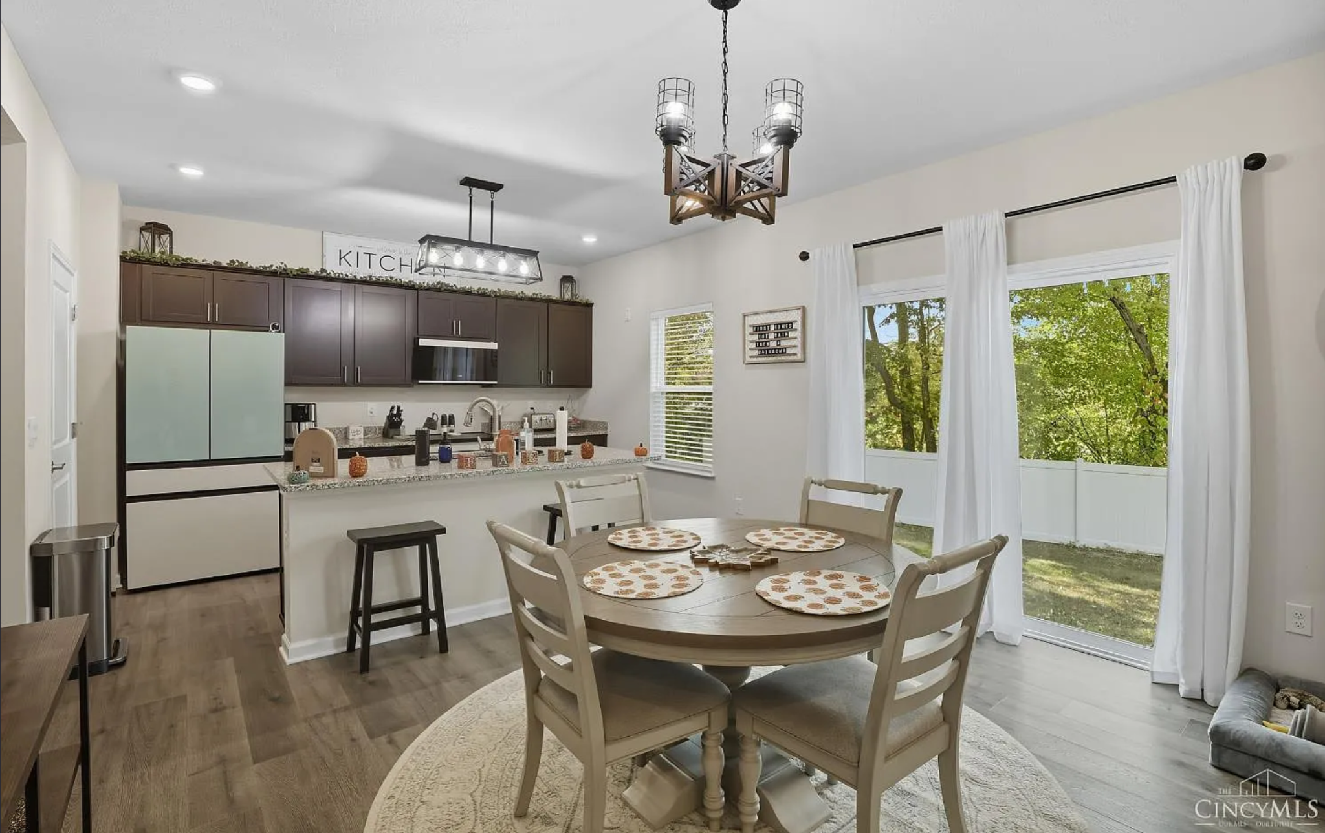
LOCATION PHOTOS
Primary Dry Demo Zone
(Dry & Heavy Duty Dry)
Why this works:
• Long straight runs for pickup passes
• Bright overhead lighting
• Open island = clean tracking lanes
• Strong contrast for dust and crumbs
Lifestyle Framing + Alternate Blocking
(Dry & Heavy Duty Dry – Secondary)
Why this works:
• Wide angles and clean background
• Ceiling fan supports Duster storytelling
• Flexible camera placement
• Simple before/after potential
Primary Duster Demo Zone
(Swiffer Duster)
Why this works:
• Ceiling fan = clear vertical dust target
• Neutral framing for close-ups
• Controlled environment
• Easy to minimally dress
Secondary Dry + Lifestyle Zone
(Dry & Heavy Duty Dry / Sweep & Mop Deluxe — Dry Use Only)
Why this works:
• Natural light from sliding doors
• Depth through kitchen into dining
• Multiple usable camera angles
• Clean walk paths for repeatable takes

Slide 18
Products
Pros
Cons
Swiffer Sweep & Mop Deluxe
Laminate and vinyl floors support light dry passes and controlled cleaning paths
Swiffer Power Mop
Limited use due to lack of confirmed tile surfaces; not recommended for primary wet demos
Swiffer Dry & Heavy Duty Dry
Laminate and vinyl flooring provide strong contrast for dust, crumbs, and pet hair pickup
Swiffer Duster
Ceiling fans and elevated surfaces in bedroom and living areas provide clear vertical dust zones
Open-concept layout allows smooth camera movement
Laminate/vinyl floors consistent throughout main living areas
Multiple ceiling fans support Duster storytelling
Strong natural light in kitchen and dining spaces
Clean, modern appearance fits target demographic
No confirmed ceramic or porcelain tile for wet demos
Limited suitability for Power Mop hero shots
Wet product demonstrations may need to be staged minimally or omitted
Fewer dedicated bathroom demo zones compared to other locations
Primarily functions as a dry/duster-focused option

Slide 19
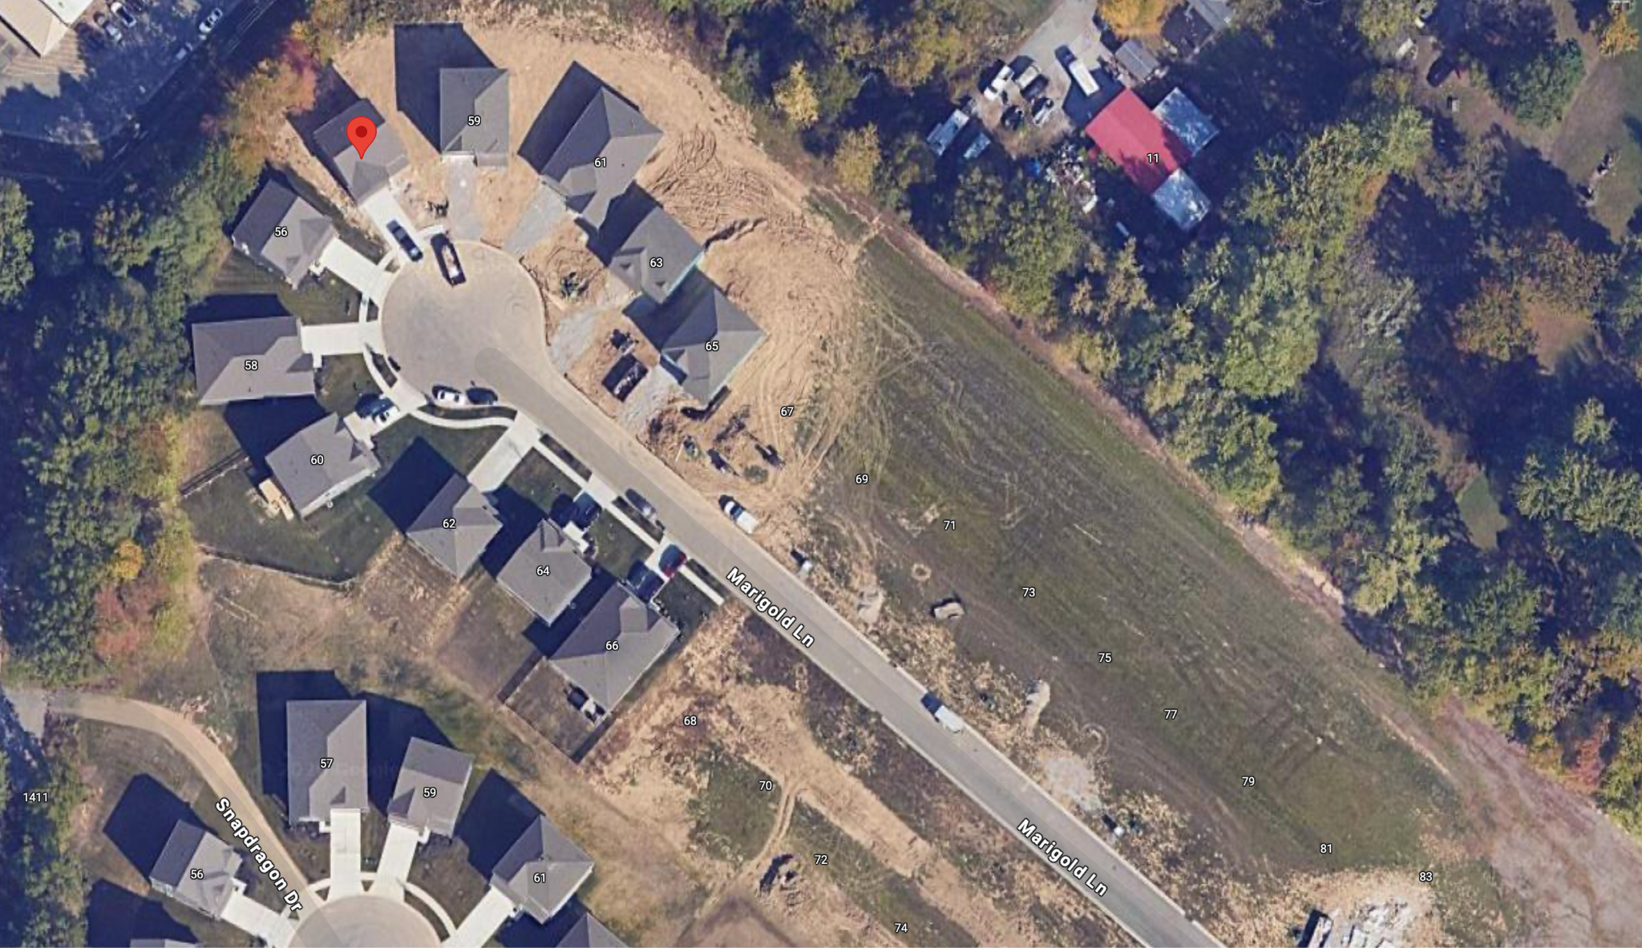
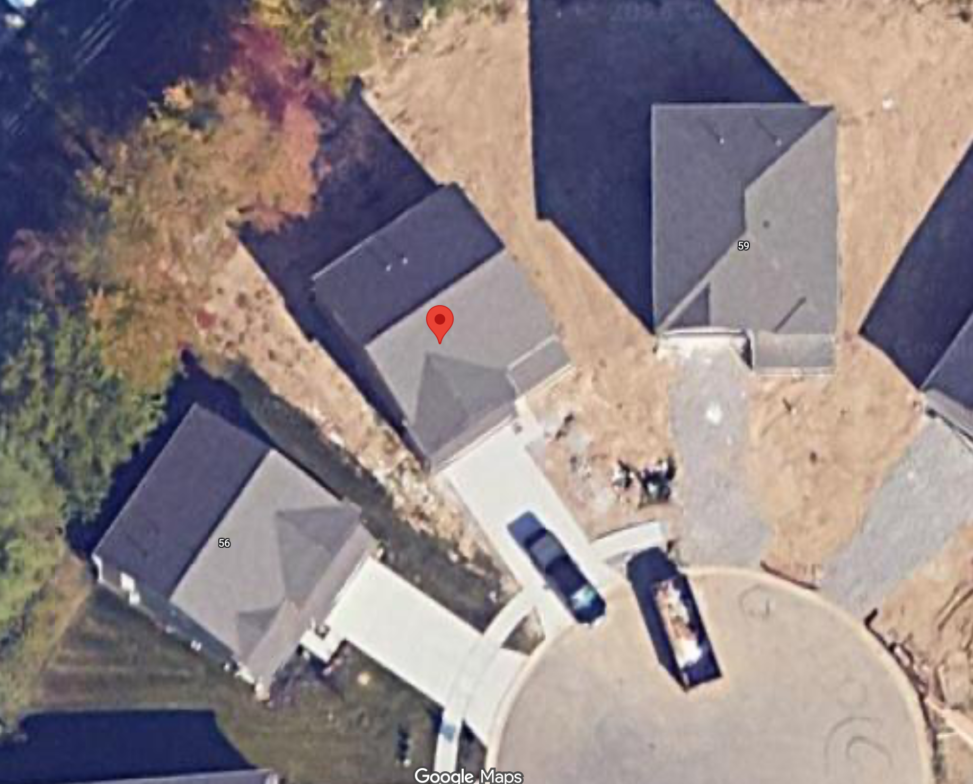
Generator
Crew Parking Side of Street
Grip Van
z
Prop Truck

Slide 20
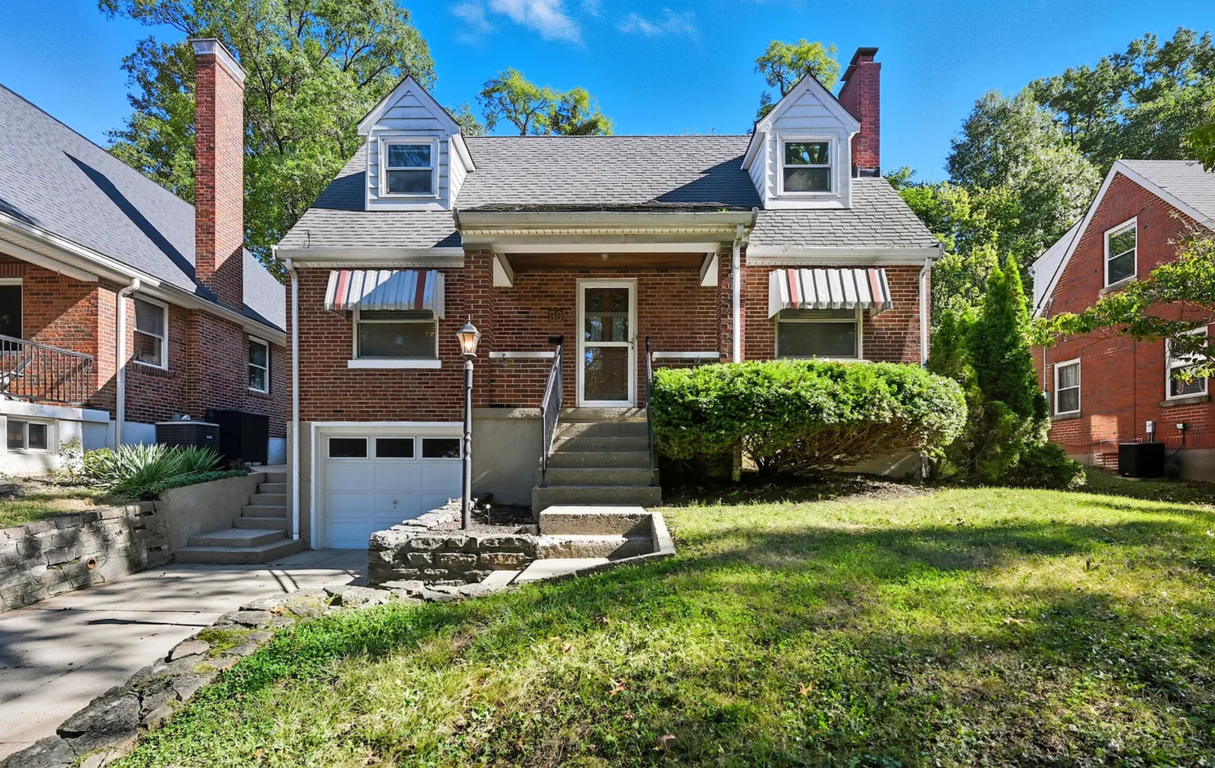
LOCATION INFO
Location 5 – Single-Family Home
30 Burdsall Ave
Fort Mitchell, KY 41017
Approx. 15 minutes from NKU

Slide 21
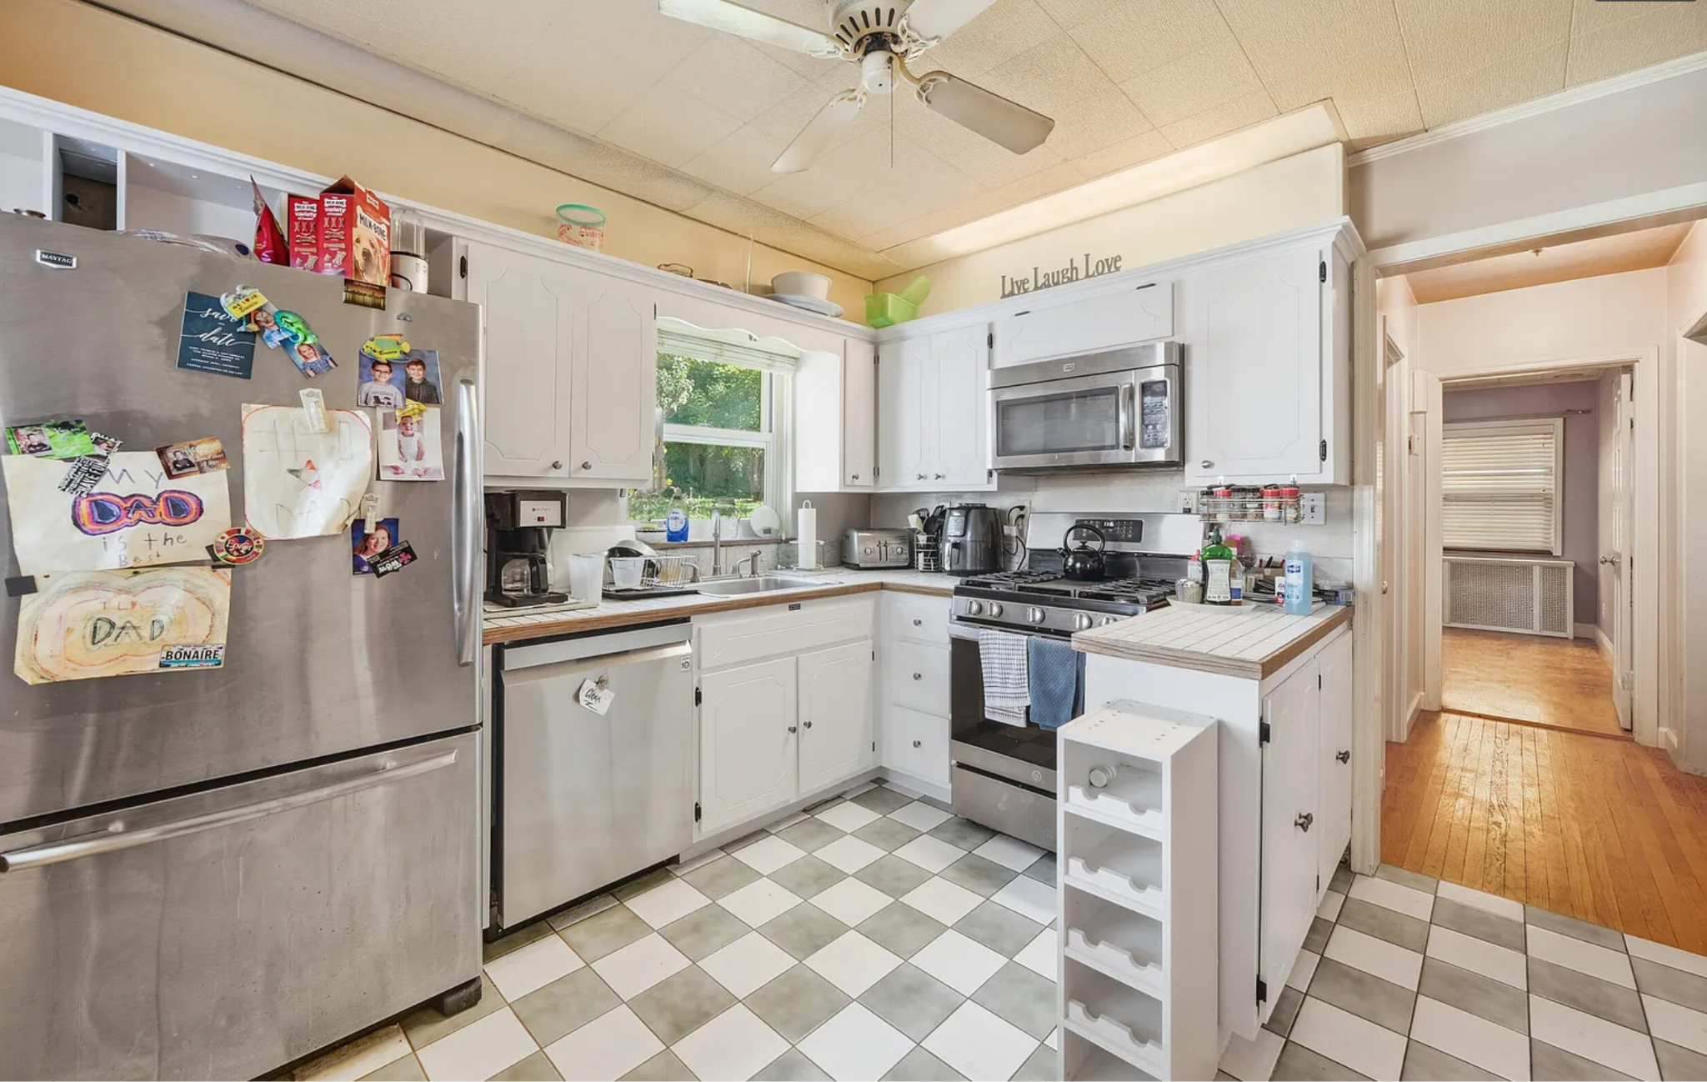
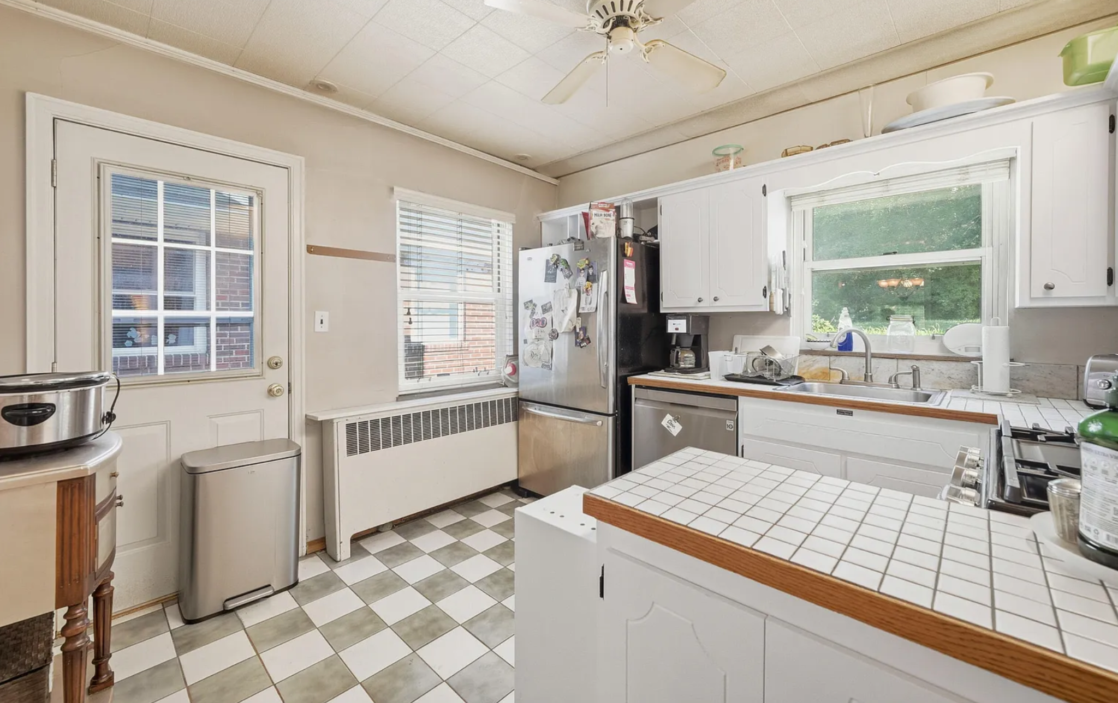
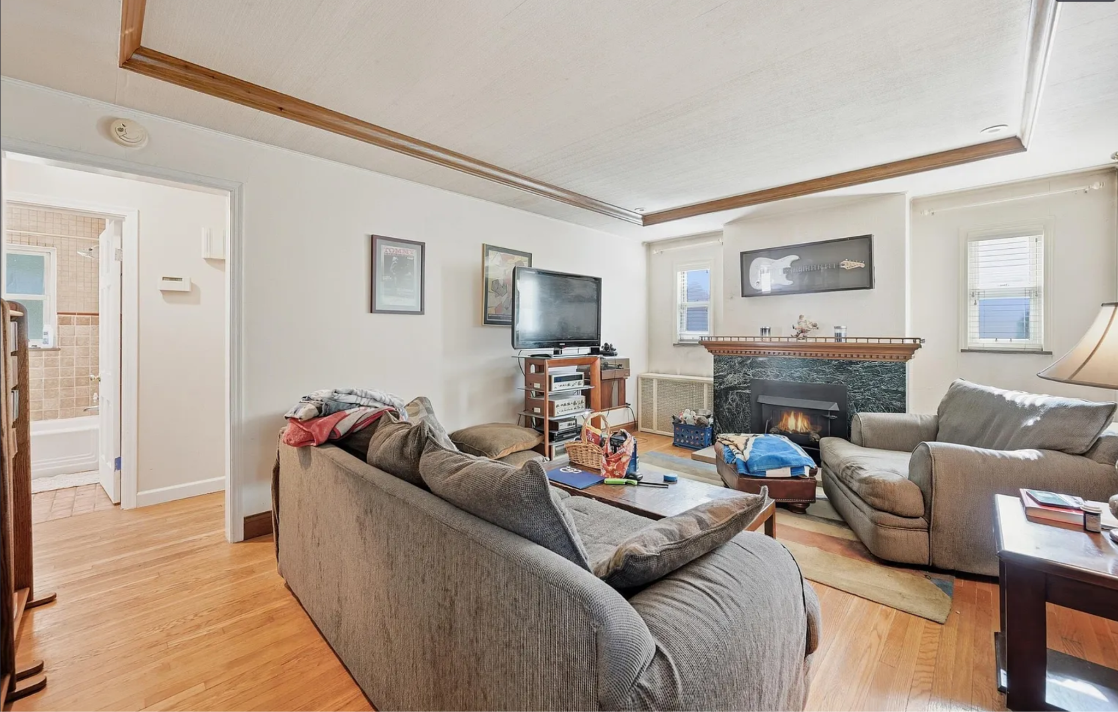
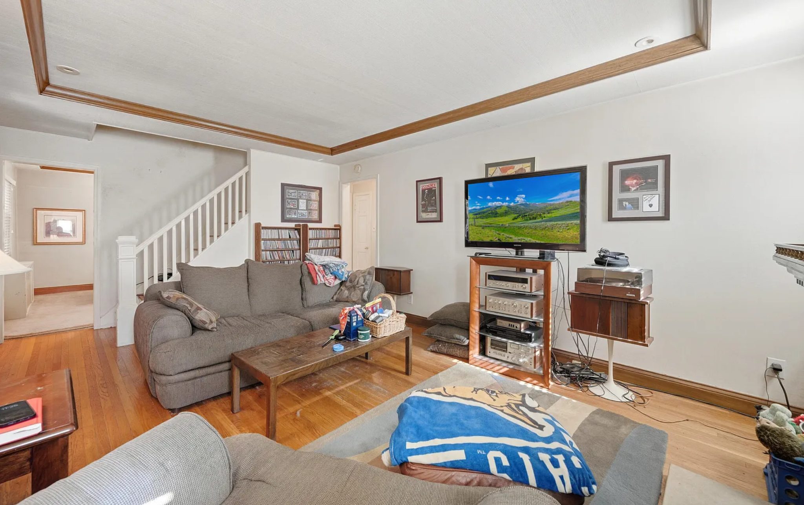
LOCATION PHOTOS
Ceramic Tile – Kitchen
Primary wet demo zone
(Swiffer Power Mop / Swiffer Sweep & Mop Deluxe)
Why this works:
Long ceramic tile runs for uninterrupted wet passes
Clean grout lines enhance residue and shine visibility
Adequate clearance for tracking and follow shots
Ceramic Tile – Kitchen / Dining
Secondary wet demo + lifestyle framing Why this works:
Natural light from window improves visibility
Shows depth between prep and dining areas
Allows director flexibility for alternate blocking
Hardwood Floor – Living Room
Dry & Heavy Duty Dry demo zone
Why this works:
Continuous hardwood floor supports long dry passes
Strong contrast between floor and area rug for debris pickup
Clear before/after storytelling potential
Living Room – Fireplace (Separate Angle)
Primary Swiffer Duster demo zone
Why this works:
Fireplace mantle offers a realistic horizontal dust surface
Multiple ledges and trim details for close-up Duster passes
Wide room depth supports lifestyle framing and coverage

Slide 22
Products
Pros
Cons
Swiffer Sweep & Mop Deluxe
Ceramic kitchen tile provides long, continuous paths for controlled wet-and-dry cleaning demonstrations.
Swiffer Power Mop
Tile flooring supports strong wet-cleaning, shine, and residue-removal shots.
Swiffer Dry & Heavy Duty Dry
Hardwood living room floors offer high contrast for visible dust and debris pickup.
Swiffer Duster
Fireplace mantle, shelving, ceiling fan, and window trim create clear vertical and elevated dust zones.
Strong ceramic tile surfaces ideal for wet demos
Kitchen layout supports consistent Power Mop and Sweep & Mop Deluxe coverage.
Continuous hardwood flooring in living spaces
Allows long tracking shots for Dry and Heavy Duty Dry content.
Multiple vertical dust targets
Ceiling fan, mantle, trim, and shelving support realistic Duster demonstrations.
Good natural light in primary rooms
Windows in kitchen and living room enhance debris and shine visibility.
Compact, controllable interior layout
Helps maintain clean sightlines and efficient camera blocking.
Limited parking due to short driveway
Only accommodates a small number of vehicles on-site.
Reliance on residential street parking
Crew and production vehicles will need to park along a narrow neighborhood street.
Potential for neighborhood noise
Residential setting may include traffic, lawn equipment, or nearby activity.
Tighter interior spaces
Kitchen and hallways may limit large camera or lighting setups.

Slide 23
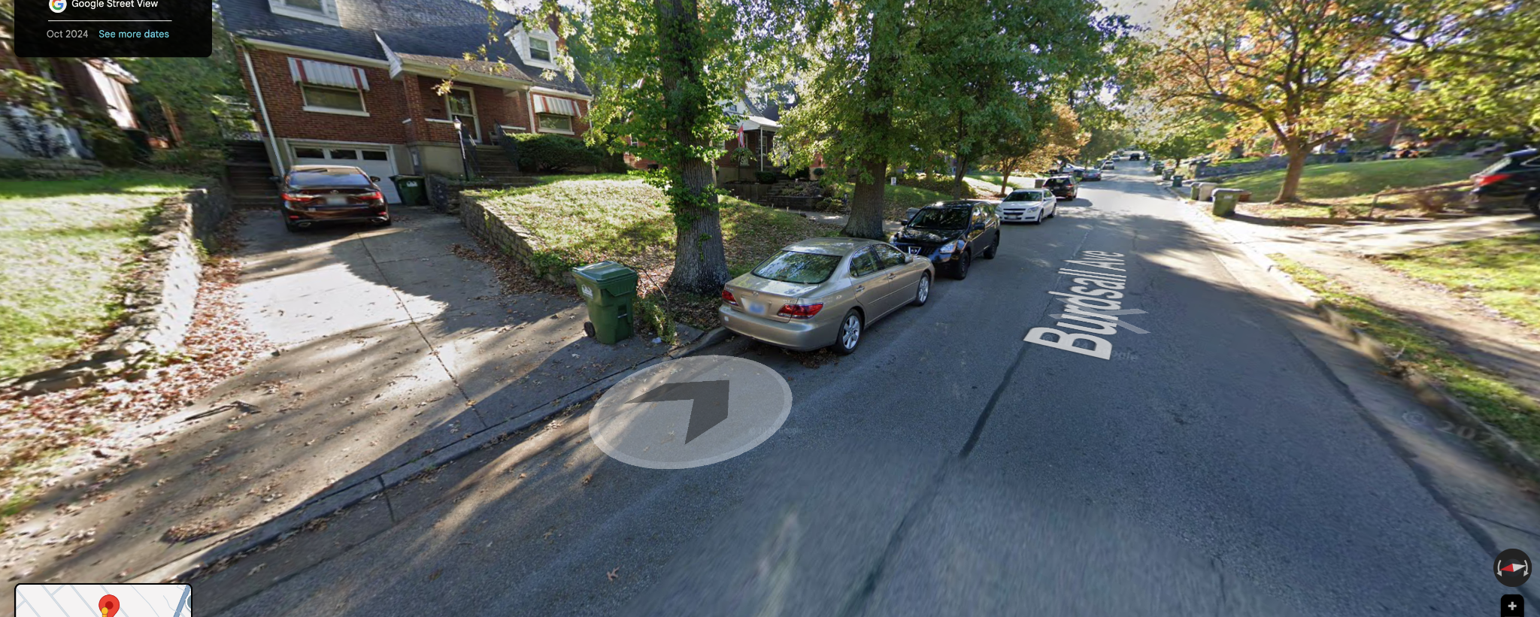
Generator
z
Grip Van
Crew Parking(Curb)
Prop Truck

Slide 24
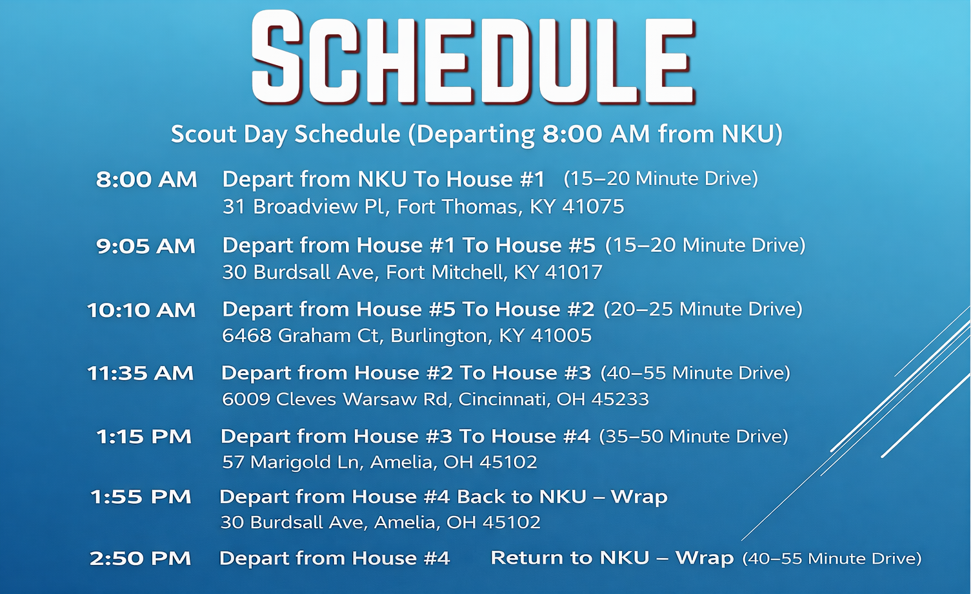

Slide 25
Final Notes
All selected locations were evaluated specifically for Swiffer product compatibility, focusing on visible contrast, realistic residential environments, and camera-friendly layouts
Each location offers at least one primary demo zone and one secondary or backup option to reduce risk during production
Natural light was prioritized across all interiors to minimize lighting needs and maintain a bright, authentic look
Parking and access were assessed at every site, with clear plans for crew, grip, and prop vehicles
Residential noise and neighborhood activity were considered, with notes identified where coordination or flexibility may be required
Locations are geographically sequenced to minimize total drive time and allow for an efficient single-day scouting route
All locations remain viable at the time of scouting, with backup options identified where availability or constraints exist
Overall Assessment:
This set of locations provides strong visual variety, realistic home environments, and flexible demo opportunities while maintaining an efficient scouting schedule and manageable logistical footprint.

